Slide 1

Learning intention
Past and present tense

Slide 2
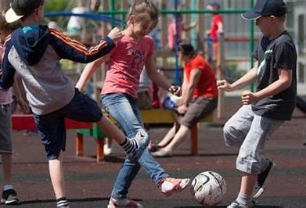
We usually play football.
Yesterday, we played football.

Slide 3
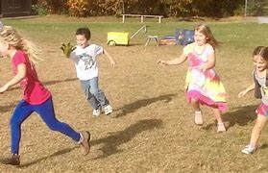
Sometimes I run around playing tag.
This morning I ran around playing tag.

Slide 4
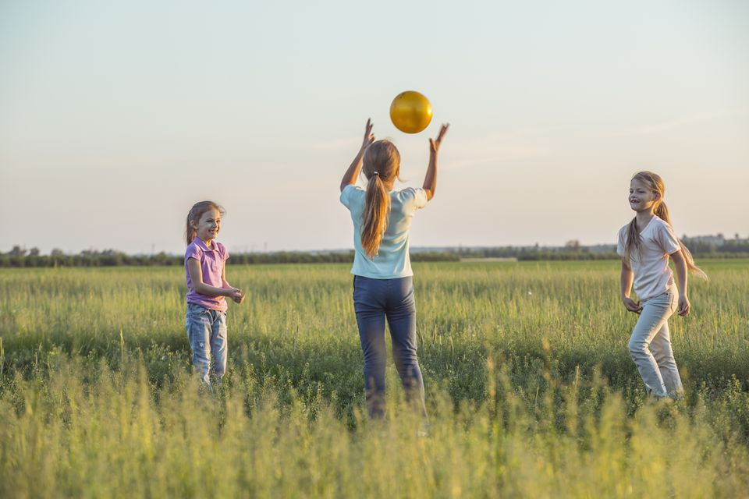
I throw the ball to my friend and she catches it
I threw the ball to my friend and she caught it.

Slide 5
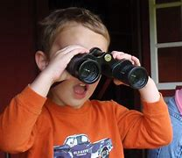

Regular or Irregular
There are two types of verbs when we write them in past tense.
Look looked run ran

Slide 6
Regular verbs (add –ed in past tense)
play
laugh
need
look
ask
call
played
laughed
needed
looked
asked
called

Slide 7
Irregular verbs (they break the rules! You just have to learn them)
go
say
make
take
think
is
went
said
made
took
thought
was

Slide 8
Now try these:
It is sunny
We have Assembly today
We go swimming
I think P.E. is fun
My dad helps me with my homework
We need to tidy up the cloakroom
It was sunny
We had Assembly today
We went swimming
I thought P.E. was fun
My dad helped me with my homework
We needed to tidy up the cloakroom

Slide 9
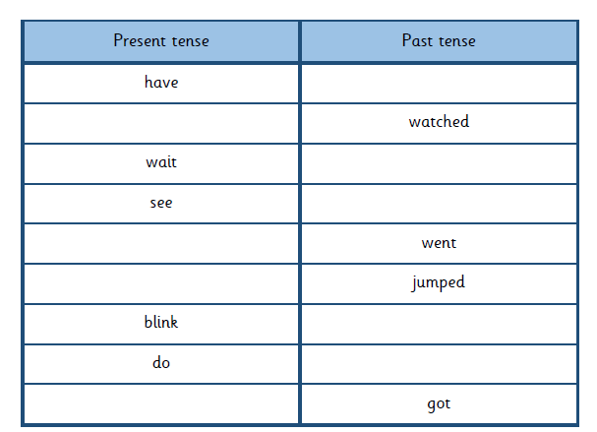
Task 2:
Complete the table with the correct form of the verb
had
Hint:
There are four regular verbs and five irregular verbs.
Remember regular past tense verbs end –ed. Irregular don’t!
go

Slide 10
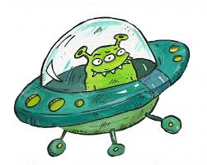
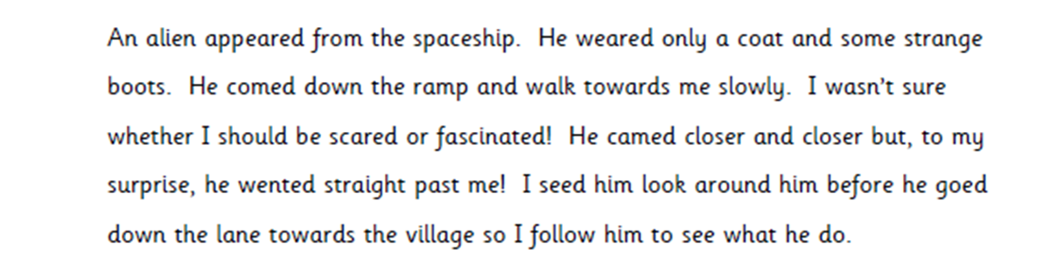
Task 2
Correct the verbs in the paragraph to make it past tense. Copy it out correctly. Read each sentence back to make sure it makes sense. Use a ruler to underline the past tense verbs.

