Slide 1
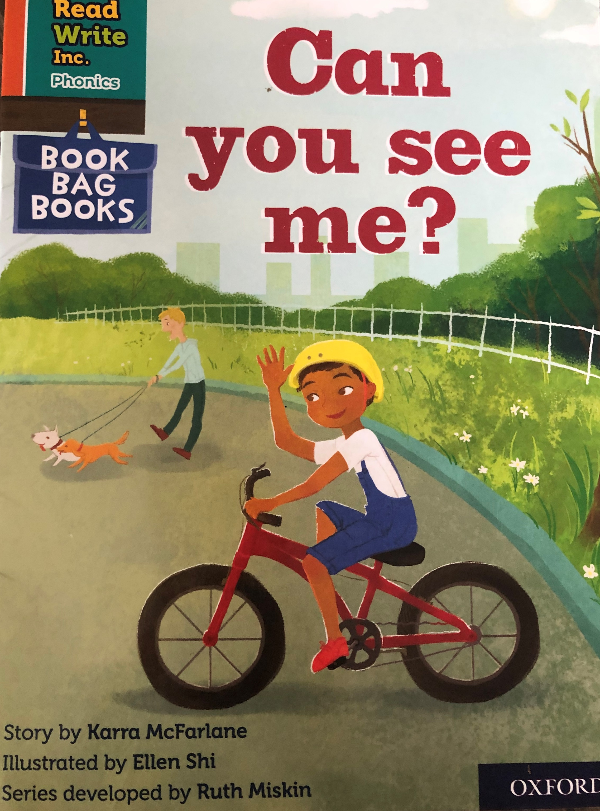
You are going to read the story ‘Can you see me?’
In this story you will hear words with the sound:
ow
The ow sound is in the words:
snow
flow
Can you write two words with the ow sound in?
Look at the picture. What can you see? What will happen in the story?

Slide 2
Let’s read these words together. These are words you will come across in the story.
Green Words
helmet
Red Words
do what
you go
to
put
my
me
I

Slide 3
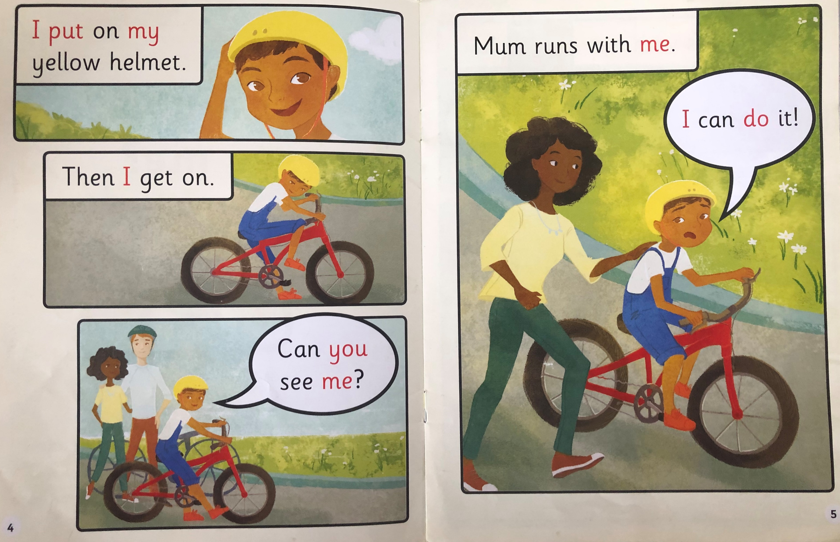
Write down all of the words you can see with the ow sound we are learning today.
What does the boy put on?
Who runs with him?

Slide 4
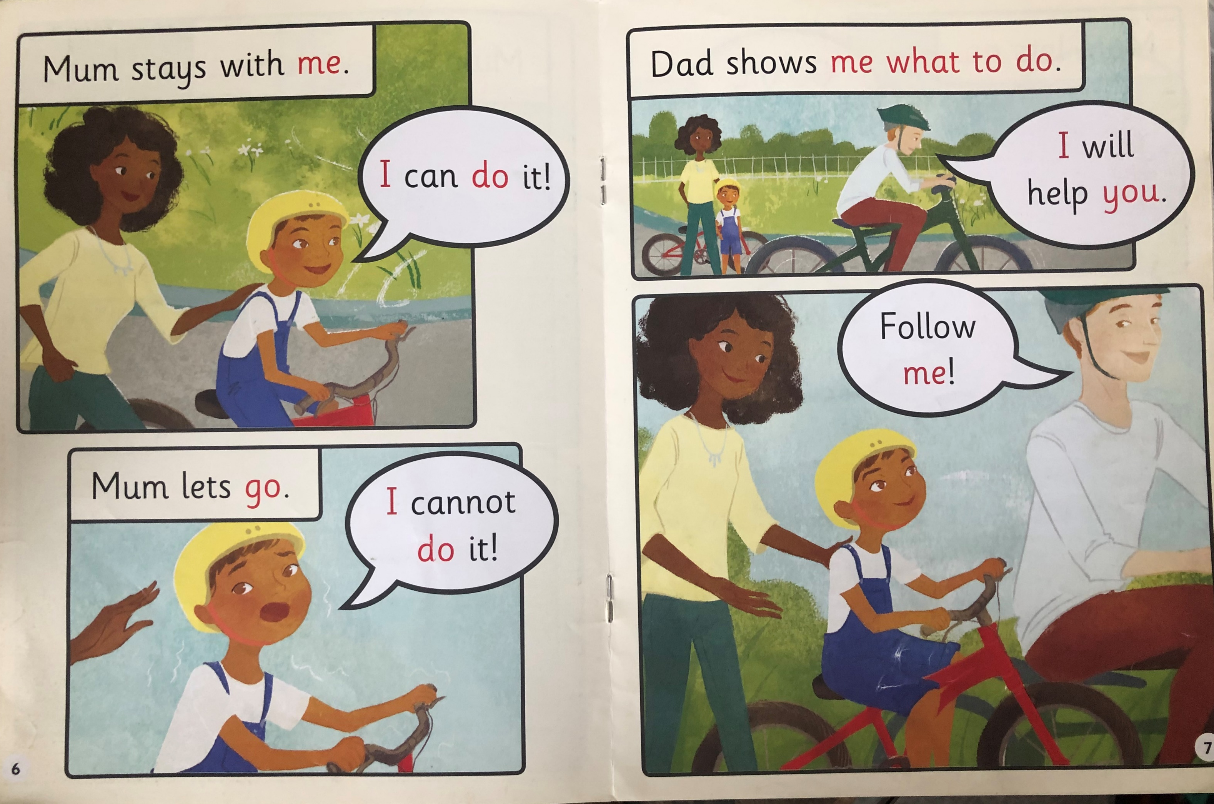
What does the boy say when mum lets go?
Who shows him hot to do it?

Slide 5
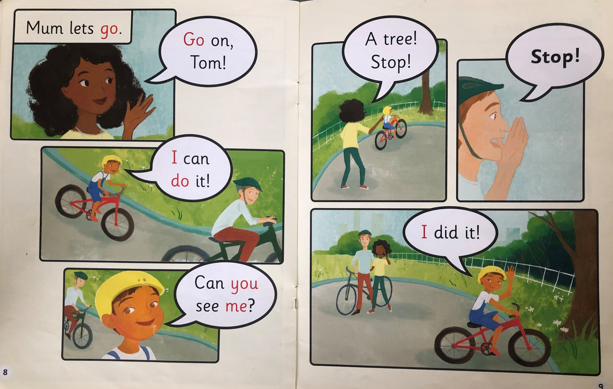
Can Tom ride his bike now?
What does mum think Tom is going to do?

Slide 6
Recap questions
What does Tom put on his head?
Who runs with Tom?
Why do Mum and Dad tell Tom to stop?
How do you think Tom feels when he rides without any help?

