Slide 1
A desert habitat
We will look at living things in their habitat.
A habitat is the natural environment/home for living things. For example, plants and animals.

Slide 2
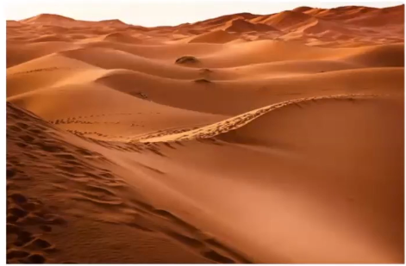
What Is a Desert?
A desert is a habitat.
Did you know that the Arctic is a cold desert. It gets very little rain or snow, about the same as a hot desert.
We are going to look at hot deserts.
This desert gets extremely hot during the day.
Surprisingly, it is very cold at night.
Some deserts are very dry.
A desert is any place that gets less than 25cm of rainfall a year.
Did You Know?
Only 20% of the earth’s deserts are covered in sand.

Slide 3
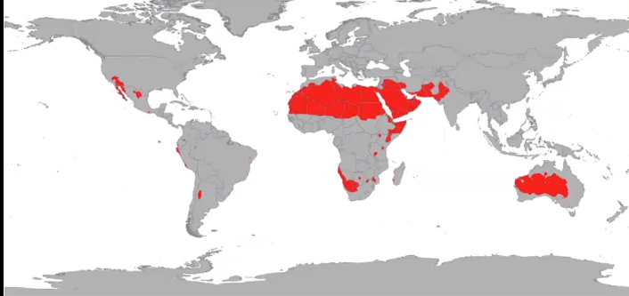
The red parts on the map of the world show where the deserts are.
There are big parts of desert in North Africa. Some in the middle east and some in the middle of Australia. There are smaller deserts in other countries.

Slide 4
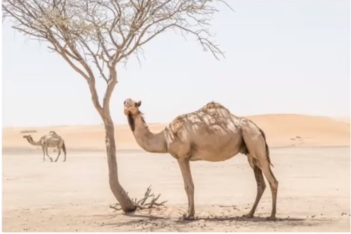
A camel is suited to a desert habitat because it can go a whole week without any water.
It has long eyelashes to keep the sand out.
It has flaps in its nostrils that can close to keep sand out in sandstorms.
Camels eat grass, seeds, grains and some plants with thorns.
Their hair reflects the sun, which helps to keep them cool.
They are used to transport people and goods across the desert.
They do not store water in their humps. It is fat so it is like a store of food.
Camel’s feet are wide to avoid slipping through sand.
The soles of their feet are thick pads to avoid burns from the hot sand

Slide 5
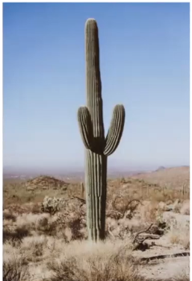
This is a cactus plant.
It has very spikey spines to protect it from been eaten.
It stores water inside its flesh. So if you cut it open it would be very juicy and full of water.
It has very long roots to find water far away underground.

Slide 6
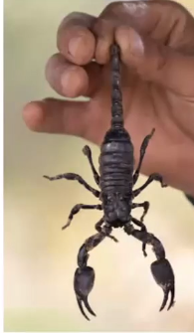
This is a scorpion.
It can go a whole year without any food.
If it is threatened it curls up and has a poisonous stinger on the end of their tail.
Scorpions have 2 eyes on the top of their heads and some have up to 5 pairs of eyes on each side of their heads.
They catch their prey with their pincers and crush it
They have an exoskeleton (a skeleton on the outside of their body) which helps them keep water in their bodies in order to survive in the harsh temperatures.

Slide 7
How would you describe a desert?
What does a camel have to help it survive in the desert?
Draw a picture of two of the organisms from this PowerPoint, label it then underneath write at least three facts about each one.
You could compare this with other habitats you have been learning about. For example a cold arctic desert with a hot desert.
If you have access to the internet you could find out more about a desert habitat here:
https://www.bbc.co.uk/bitesize/topics/zx882hv/articles/zsqnfg8

