Slide 1

Year 1 – Art
Learning Intention: To recreate a piece of artwork.

Slide 2
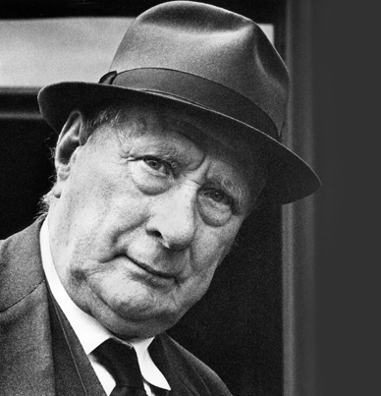
We have been learning about
L.S Lowry

Slide 3
Lets have a look at some of his artwork. Tell your grown up what you can see in each picture. Do you like the picture?

Slide 4
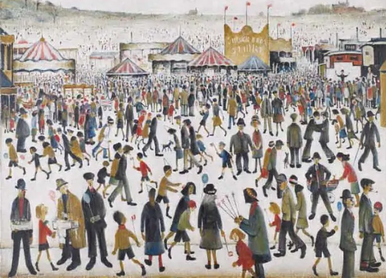
What can you see?
Do you like this picture?

Slide 5
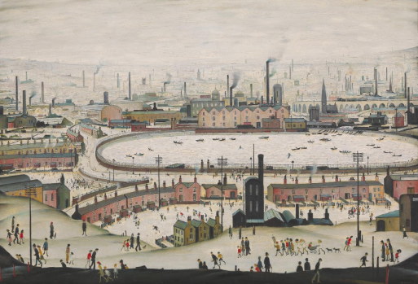
What can you see?
Do you like this picture?

Slide 6
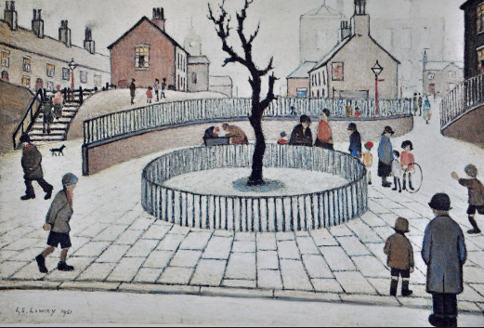
What can you see?
Do you like this picture?

Slide 7
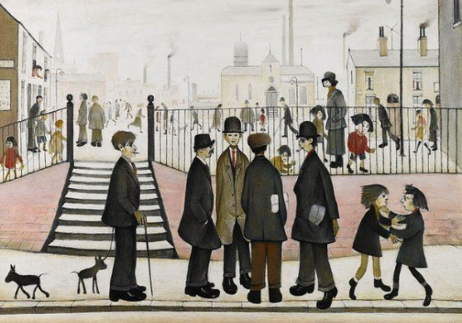
What can you see?
Do you like this picture?

Slide 8
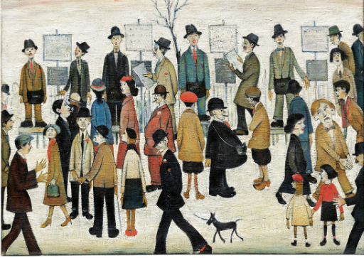
What can you see?
Do you like this picture?

Slide 9
Can you choose your favourite L.S Lowry picture and, on the worksheet, see if you can draw it?

