Slide 1
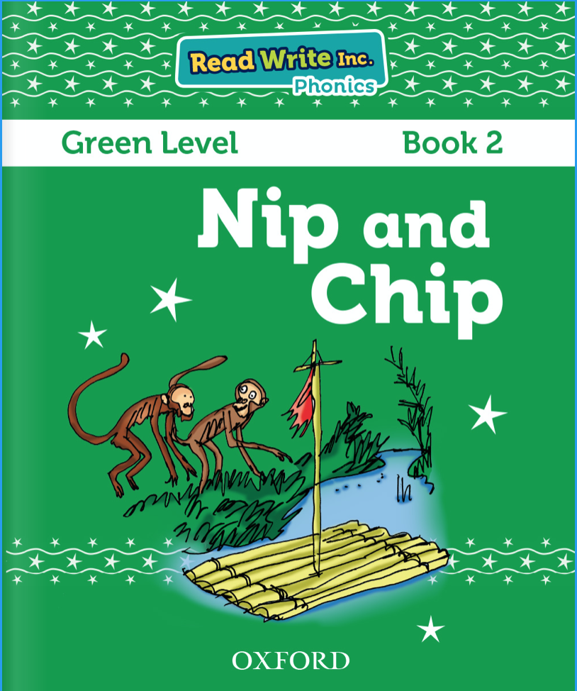
Today we will read the first story from this book.
You can find it on Oxford Owl. > ebooks> rwinc> green level
https://www.oxfordowl.co.uk/api/interactives/29256.html
Read by yourself first then you could listen to the teacher read the story on the PowerPoint.

Slide 4
