Slide 1
Multiplying proper Fractions

Slide 2
Can you name the parts of a fraction?
numerator
$$\frac{3}{4}$$
?
denominator
?

Slide 3
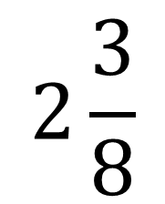
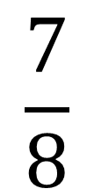
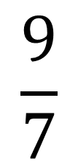
What sort of fractions / numbers are these:
$$\frac{7}{8}$$
?
proper fraction
?
$$2\frac{3}{8}$$
mixed number
?
$$\frac{9}{7}$$
improper fraction

Slide 4
Multiplying Fractions
$\frac{2}{3}$×$\frac{3}{4}$=
Multiply the numerators.
Multiply the denominators.
Simplify.
Remember when we simplify a fraction we find a common multiple of both the numerator and denominator and divide it.
e.g. 8/12
Both of these are multiples of 4 so divide them both by 4. The simplified fraction is 2/3
2 × 3 6
$$\frac{1}{2}$$
=
=
3 × 4 12

Slide 5
Try these:
$\frac{2}{5}$ × $\frac{3}{4}$=
$\frac{1}{4}$ × $\frac{1}{2}$=
$\frac{3}{4}$ × $\frac{4}{5}$=
$\frac{4}{7}$ × $\frac{2}{5}$=
$\frac{1}{6}$ × $\frac{2}{5}$=
$\frac{5}{12}$ × $\frac{2}{5}$=
$\frac{5}{9}$ × $\frac{2}{3}$=
$\frac{3}{8}$ × $\frac{4}{9}$=

