Slide 1
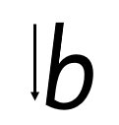
Focus sound: b
b -Start at the top, come all the way down, bounce half way back up and go all the way around

Slide 2
Your turn! Write b in your book using the lines.
Then try:
bag
box
bed

