Slide 1
Set 2 Sounds
or
Notes:
Lets practise our set 2 sounds, today;’s sound is or

Slide 2
Notes:
What is the alien doing? That’s right, he needs to shut the door

Slide 3
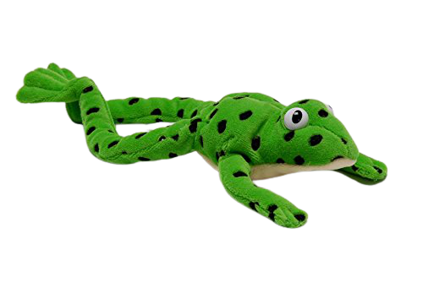
Notes:
Lets fred talk! D-oor, door, sh-or-t, short, s-p-or-t, sport

Slide 4
Notes:
This is our new sound or. It has 2 letters but 1 sound, it’s a special friend

Slide 5
Notes:
Lets practice or. My turn first…..

Slide 6
Notes:
Now can you practice or, off you go

Slide 7
sort
_
.
.
fork
_
.
.
sport
_
.
.
.
Notes:
Lets read some green words! First lets use fred talk then read the word

Slide 8
Notes:
Let’s practice writing our sound - or

Slide 9
Notes:
Let’s practice writing words with the or sound in them storm, door, snort

