Slide 1
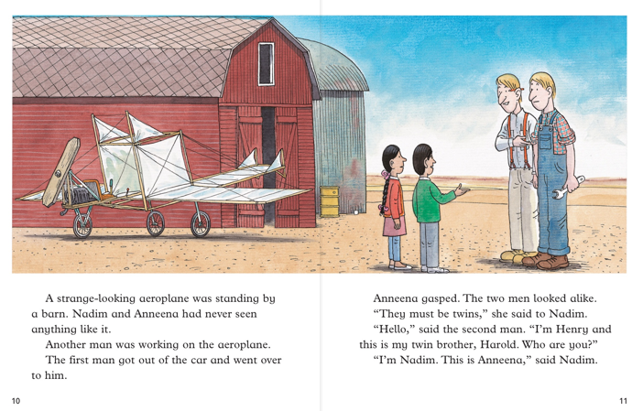

Slide 2
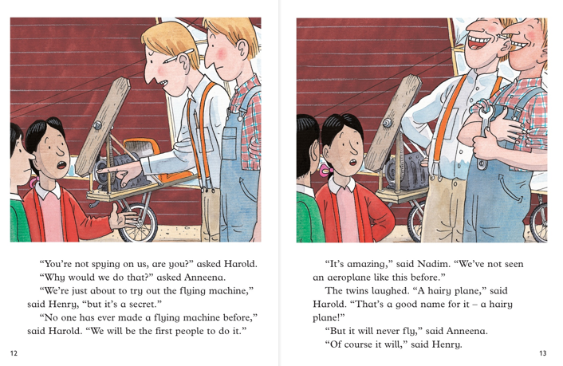

Slide 3
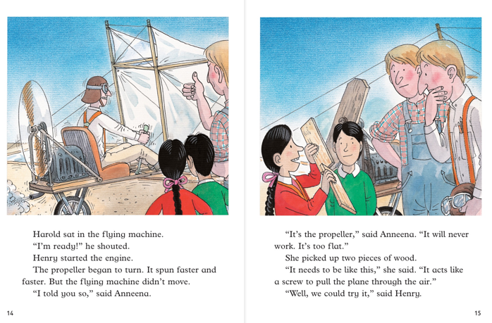

Slide 4
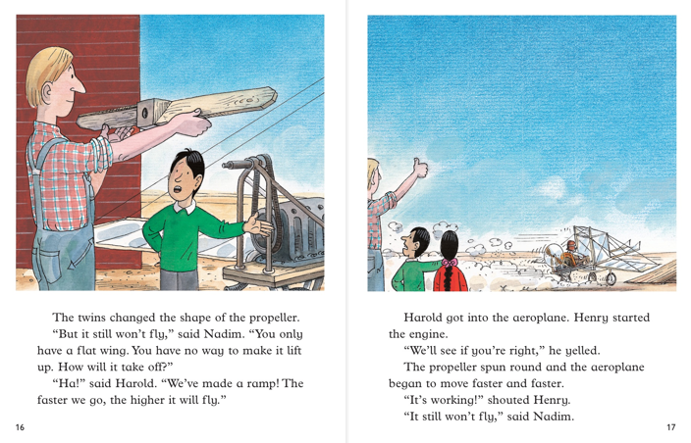

Slide 5
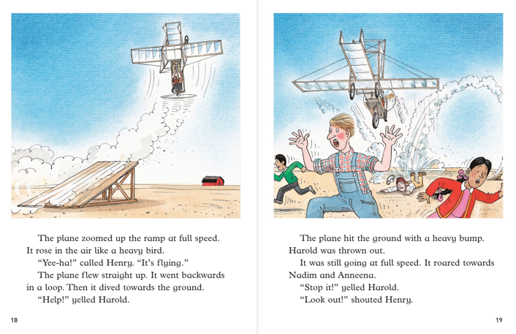

Slide 6
The flying machine flew up into the air but then crashed to the ground.
Nadim and Anneena meet Henry and Harold who are twins.
Anneena suggests they change the shape of the propella.
Harold and Henry think Nadim and Anneena might be spying on their idea.
Henry tries to fly the plane but it doesn’t work.

