Slide 1
Identify and explore key London landmarks

Slide 2
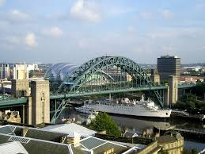
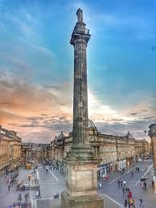
What is a landmark?
A landmark is a building, structure or place that is easily recognisable.
It connects people to a place and can inspire people to visit it.
Here are some of our local landmarks in Newcastle
Tyne Bridge
Greys Monument

Slide 3
London Landmarks
The capital city of England is London. The city has many landmarks.
Can you name any?

Slide 5
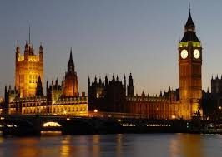
Big Ben
This landmark stands over 96m high. It is named after the 13.5 tonne bell housed within its tower. It has been here since 1859 and is the world’s largest clock.
Houses of Parliament
With 900 years of history, this is where the House of Commons and the House of Lords meet.

Slide 6
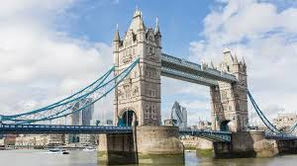
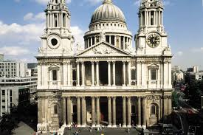
Tower Bridge
First opened in 1894, this London landmark is opened at least once a day now. But, if you need it to open, you must give 24 hours’ notice- make sure the cars and buses have stopped first!
St Pauls Cathedral
This iconic, world famous dome is a main feature of London’s’ skyline. It is the home of the Bishop of London

Slide 7
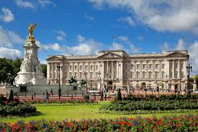
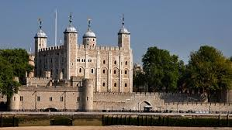
Tower of London
The oldest part of this landmark was built in 1078 by William the Conqueror. As well as being a royal house, this building has also been a prison. It is now home to Yeoman Warders, ravens and the Crown Jewels.
Buckingham Palace
The Queen’s official London home, this building has 775 rooms, including 240 bedrooms, 78 bathrooms, a cinema and a swimming pool.

Slide 8
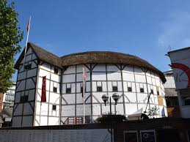
Shakespeare’s Globe Theatre
This is a reconstruction of the Globe Theatre which was an Elizabethan playhouse. William Shakespeare, England’s finest playwright wrote his plays which were performed there.
Millennium Dome (O2 Arena)
The Dome, is the original name of a large dome shaped building originally used to house the Millennium Experience, a major exhibition celebrating the beginning of the millennium.

Slide 9
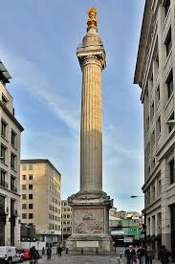
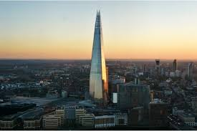
The Shard
At 309.6m tall, this isn’t just the tallest building in London, it’s the tallest in Europe. Amazingly, it is 95 storeys tall!
.
The Monument
This was built to commemorate the Great Fire of London. It stands at the junction of Monument Street and Fish Street Hill and is 62m high. It is just west of the spot in Pudding Lane where the Great Fire started on 2 September 1666.

Slide 10
If you were going to visit London for a day, which are the three main sights you would want to see?
Why would you like to see them?

Slide 11
Finally try the quiz
Answer these questions about famous London landmarks.
1. Which landmark has to have permission to open?
2. Which landmark is the tallest building in the UK?
3. Which landmark is a memorial to the Great Fire of London?
4. Which landmark used to be a prison?
5. Which landmark is 96 metres high?
6. Which landmark has a thatched roof?
7. In which landmark does the Queen live?

Slide 12
Finally try the quiz
1. Tower Bridge
2. The Shard
3. The Monument
4. Tower of London
5. Big Ben
6. Shakespeare’s Globe Theatre
7. Buckingham Palace

