Slide 1
Learning Objective To multiply numbers

Slide 2
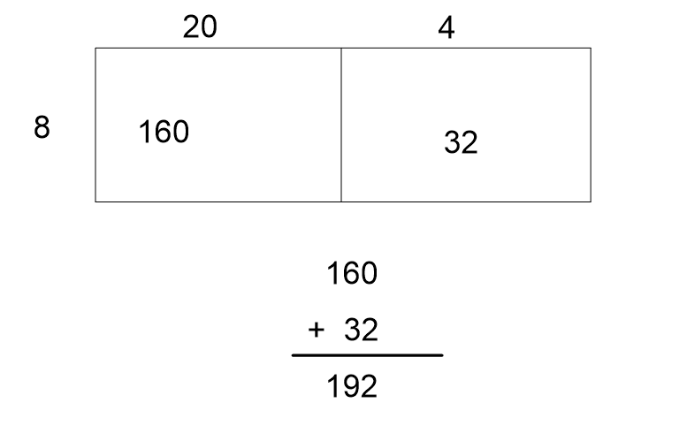

Slide 3
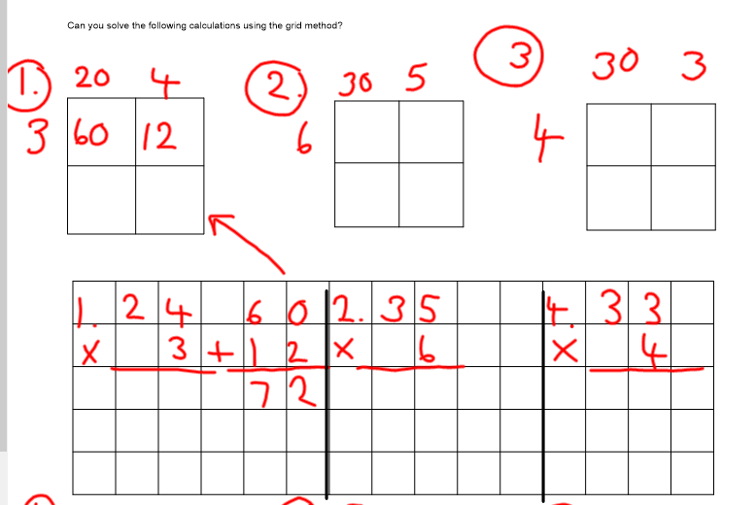

Slide 4
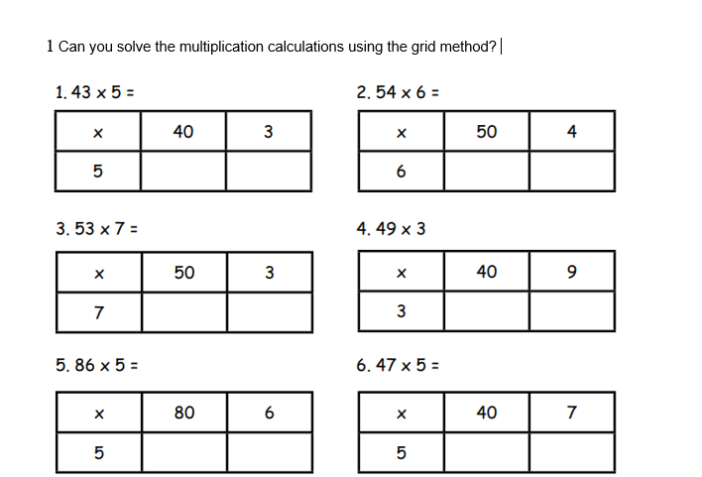

Slide 5
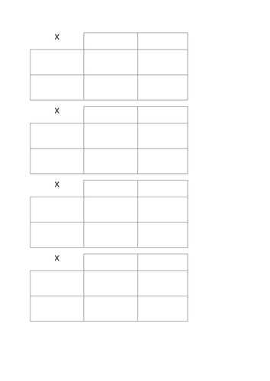

Slide 6
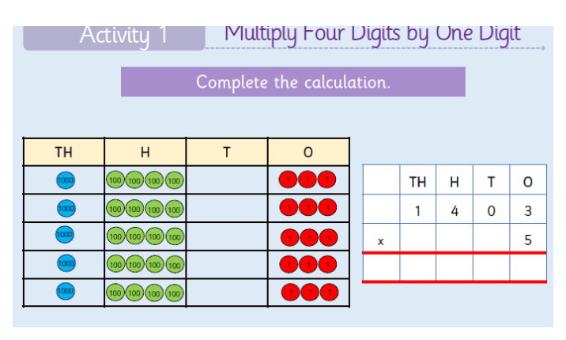

Slide 7
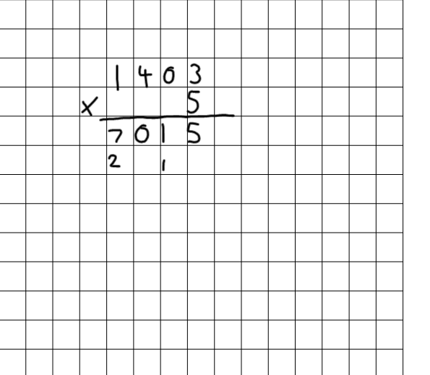

Slide 11
We will first multiply 2 6 x 3 7 8 1 Then 2 6 x 1 0 2 6 0 Then we add the answers together 7 8 + 2 6 0 3 3 8 1

Slide 15
