Slide 1
Purple/pink/orange/yellow RWI
Today we are going to look at pictures from a story.
This story is a traditional tale: have a look at the examples on the next page to find traditional tales you know.

Slide 2
Snow White
Jack and the Beanstalk
Little Red Riding Hood
Examples
The Pied Piper
Peter and the Wolf

Slide 3
Features of traditional tales:
Fairy tale language such as ‘once upon a time’
Magic
Good and evil characters
They are fiction

Slide 4
Look at the following pictures.
Have a think about what you see.
Can you decide if the statements are true or false? Explain your reasons.

Slide 5
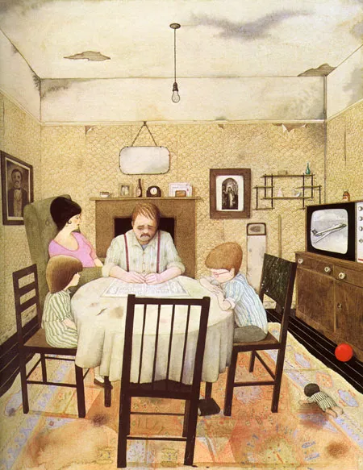
What do you notice in the picture?
True or false:
There is a family in the room.

Slide 6
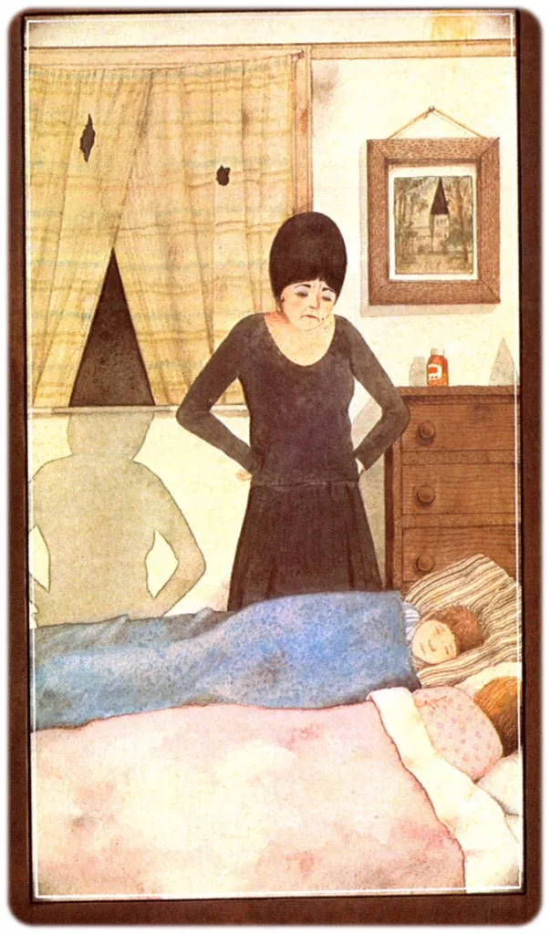
What do you notice in the picture?
True or false:
The step mother loves the children.

Slide 7
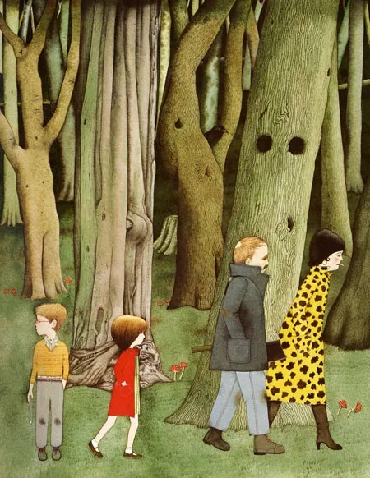
What do you notice in the picture?
True or false:
The story is set in the woods.

Slide 8
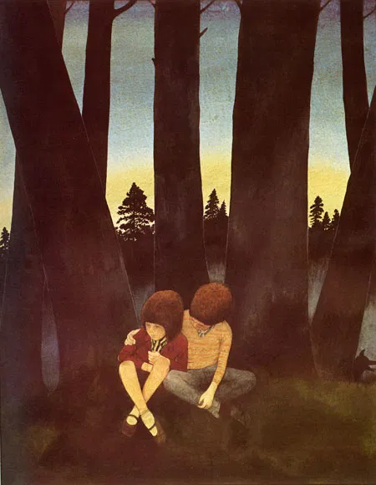
What do you notice in the picture?
It is in the morning.

Slide 9
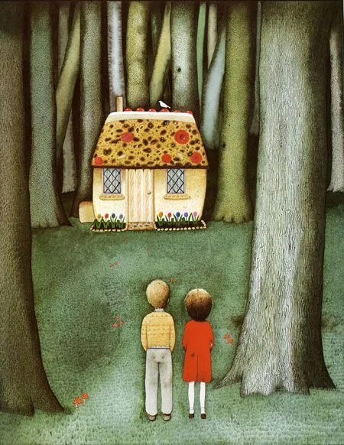
What do you notice in the picture?
Who do you think lives in the house?

Slide 10
Does this traditional tale remind you of any other stories you have heard before?
What do you think the rest of the story will be about?

