Slide 1
Learning Intention
To use information from different sources to answer questions

Slide 2
Key Vocabulary
Primary sources Primary sources are original first-hand accounts of an event, topic or historical time period. For example diary entries, letters and artefacts.
Secondary sources These are second-hand accounts – for example a reference book, someone retelling stories they were told by their grandparents
Evidence Proof that something has happened or exisisted
Archaeology It is the study of things that people made, used and left behind

Slide 3
Recap our learning from last week
King Vortigern, leader of the Britons, invited two Saxon brothers, called Hengist and Horsa to support them in their battles against the Picts.
They were fearful that the Picts would conquer the Anglo Saxon kingdoms as they were deemed fearless fighters with excellent tactics.
What historical evidence is there to prove these ideas?

Slide 4
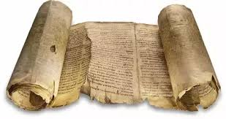
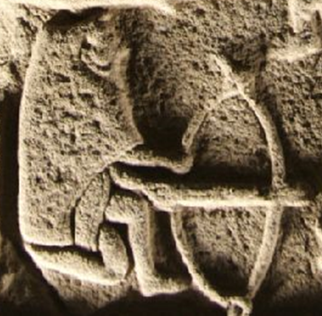
Were the Picts fearsome fighters who could conquer the seven kingdoms?
An original manuscript by Claudius Claudianus writing in the early 6th century wrote of the Picts as people: ‘clothed in the skin of the Caledonian beast, their cheeks tattooed, deep blue cloaks sweeping down to their feet.’
A fortress lived in by the Picts.
Why might it be a good place to live?
What can you see on these stone carvings?

Slide 5
What do these primary sources show us about the Picts?

Slide 6
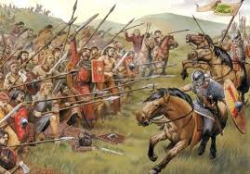
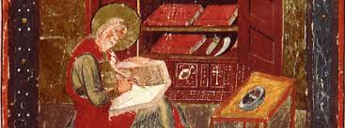
A battle site 685AD where the Picts waited for their enemies to arrive.
Bede’s diary says ‘the Picts with their king emerged as victors, and the Saxon thugs never again ventured forth to their land’
A broch that has been excavated by archaeologists to explore the life of Pict fighters.

Slide 7
Now it’s your turn
Can you work with someone at home to look carefully again at the primary and secondary sources and consider our question.
Were the Picts fearsome fighters who could conquer the seven kingdoms?
Can you explain the reasons for your opinions.
I believe the Picts were impressive fighters because …………..

