Slide 1
Investigate music from the past

Slide 2
Today we are going to learn about music history that was recorded and played in the 1970s. We will also learn about the different meanings of the musical notes. Music from the 1970’s is still listened to today!

Slide 3
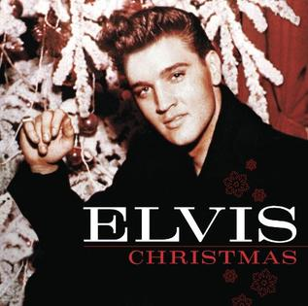
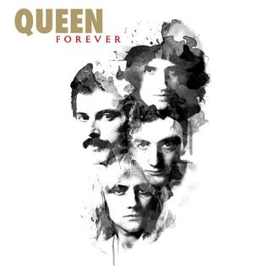
Music History in the 1970s Here are some of the different musicians:
Stevie Wonder

Slide 4
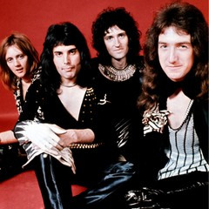
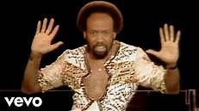
There were many different styles of music in the 1970s. Some of these were: Funk, Soul, R&B, Pop, Hard Rock, Soft Rock and Disco.
Soul Music
Funk Music
Hard Rock Music

Slide 8
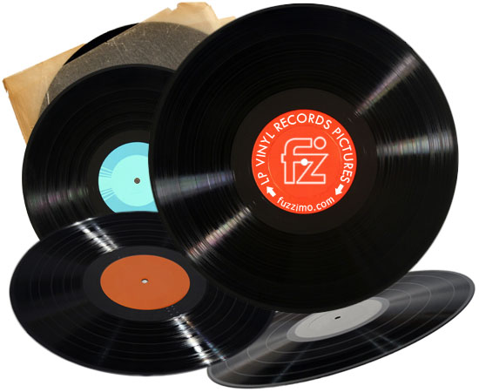
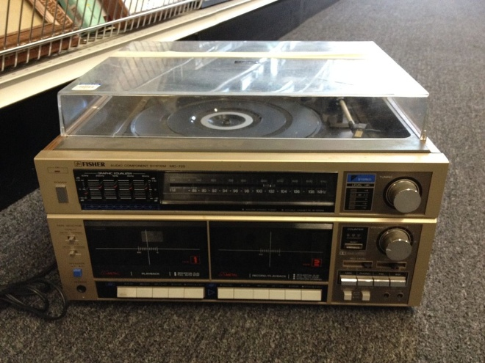
In the 1970s there were different ways of listening to music like using the a radio and by playing vinyl records.
What is a vinyl record?
Vinyl records were used to play music, like using music downloads now. Vinyl's are played on a record player.
Vinyl record
Record Player

Slide 9
Musical instruments in the 1970’s were some of the best. They were made to last a long time. In fact there are still a lot of the 1970’s equipment still used today. These include Drums, Bass Guitar and Paino.

Slide 10
In this decade songs were recorded by different artists. Some of the songs are now being re-released by new artists.

