Slide 1

Year 5
Science

Slide 2
Learning Objective
To recognise the features of a mammal and an amphibian

Slide 3
What is a mammal?

Slide 4
A mammal is an animal that breathes air, has a backbone, and grows hair at some point during its life. In addition, all female mammals have glands that can produce milk. Mammals are among the most intelligent of all living creatures. The female mammal gives birth to live offspring ( babies ).
Mammals include a wide variety of animals, from cats to humans to whales. There are more than 5,000 species, or kinds, of living mammal. More than half of all mammals are rodents, a group that includes mice and squirrels.

Slide 5
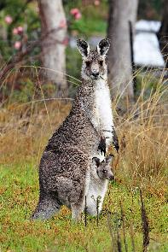
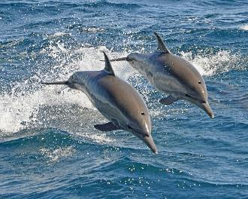
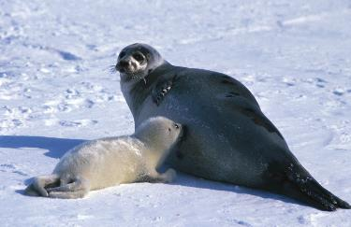
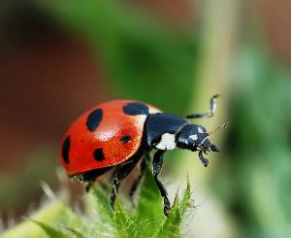
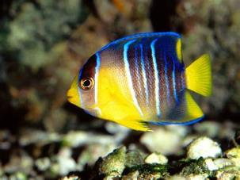
Which of the following creatures are mammals?

Slide 6
Where do mammals live?

Slide 7
Mammals are found in every major habitat around the world. Mammals live on land, on the ground, in trees, or even underground. Some mammals—including otters, beavers, and seals—live on land and in the water. Whales, dolphins, and manatees are mammals that spend their whole life in water.

Slide 8
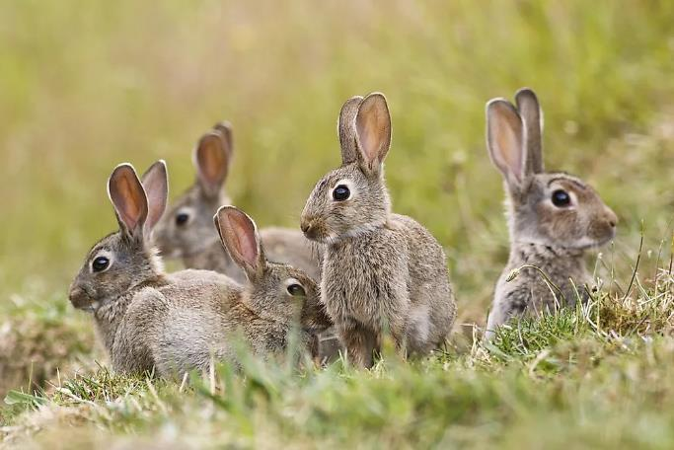
Where do you think this mammal lives?

Slide 9
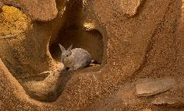
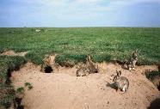
A rabbit burrow is an underground system of tunnels which run in several directions and contain nesting areas, runs and emergency exits. Since rabbits are social animals and often live in small groups it's not uncommon to find a group of rabbit holes or burrows linked together in a small area. This underground tunnel system is called a warren.

Slide 10
What is an amphibian?

Slide 11
Amphibians are vertebrate animals (have a backbone)
They are cold-blooded, which means their body temperature is regulated by their surrounding temperature.
Amphibians are also characterised by their smooth, slimy skin and their lack of scales, feathers or hair. Their skin is permeable (which means air can pass through the skin) and many amphibians therefore breathe through their skin instead of through their lungs.

Slide 12
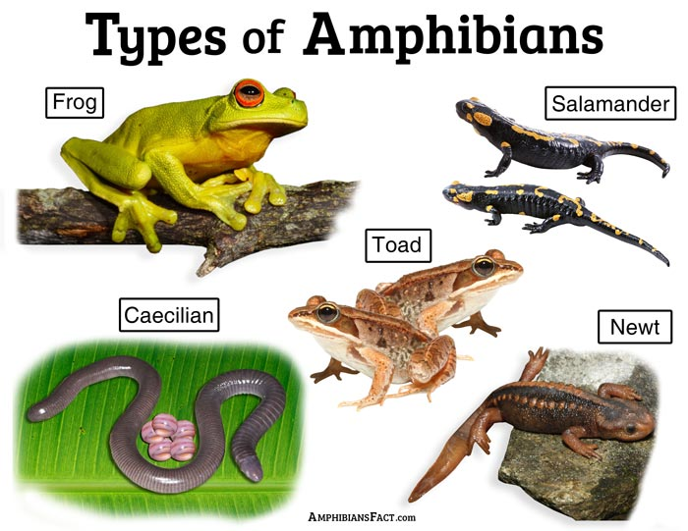

Slide 13
Where do amphibians live?

Slide 14
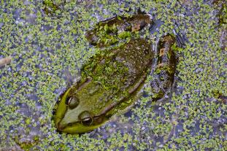
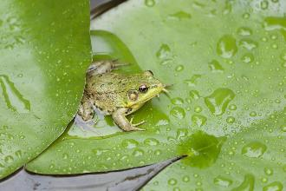
Amphibians have adapted to live in a number of different habitats including streams, forests, meadows, bogs, swamps, ponds, rainforests, and lakes. Most of them like to live in or near water and in damp areas.
Here is a frog living in its habitat – a pond or lake. Frogs can not live in salt water.

Slide 15
Fun Facts about Amphibians
Most amphibians have thin, moist skin that helps them to breathe.
Amphibians are considered vertebrates as they have a backbone.
Frogs swallow their food whole. The size of what they can eat is determined by the size of their mouths and their stomach.
Frogs cannot live in salt water.

