Slide 1
Art
Learning intention: To learn about a great artist in history – Nicky Phillips

Slide 2
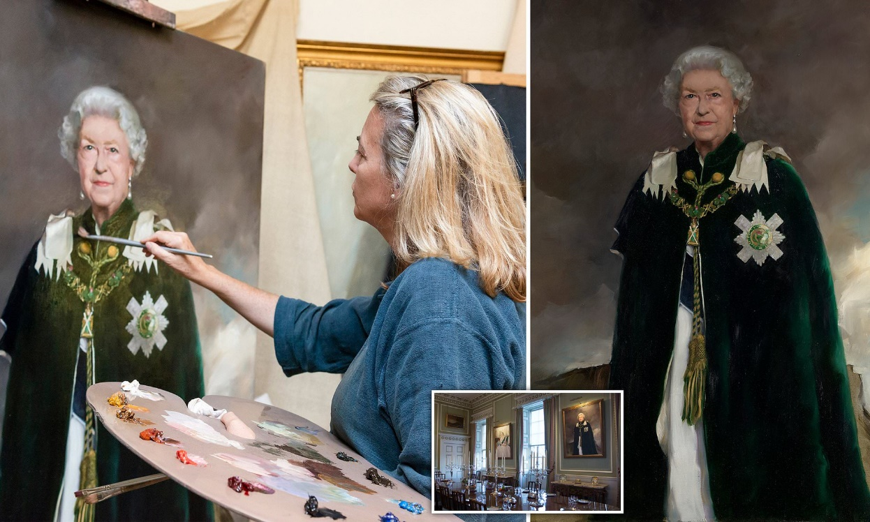
Nicky Phillips
Nicola Jane Phillips (often known as Nicky Phillips) is a British artist whose most famous works are portraits of the royal family using oil paint.

Slide 3
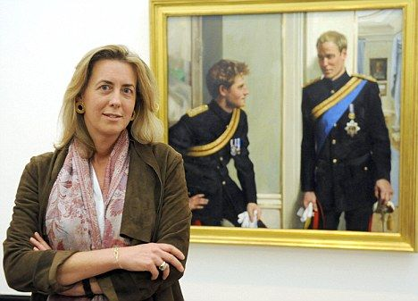
Nicky Phillips
Early life
On 27th August 1964, Nicky Phillips was born in Pembrokeshire, England. Her mother and father are also very artistic so it is not a surprise that Nicky is such a good artist.

Slide 4
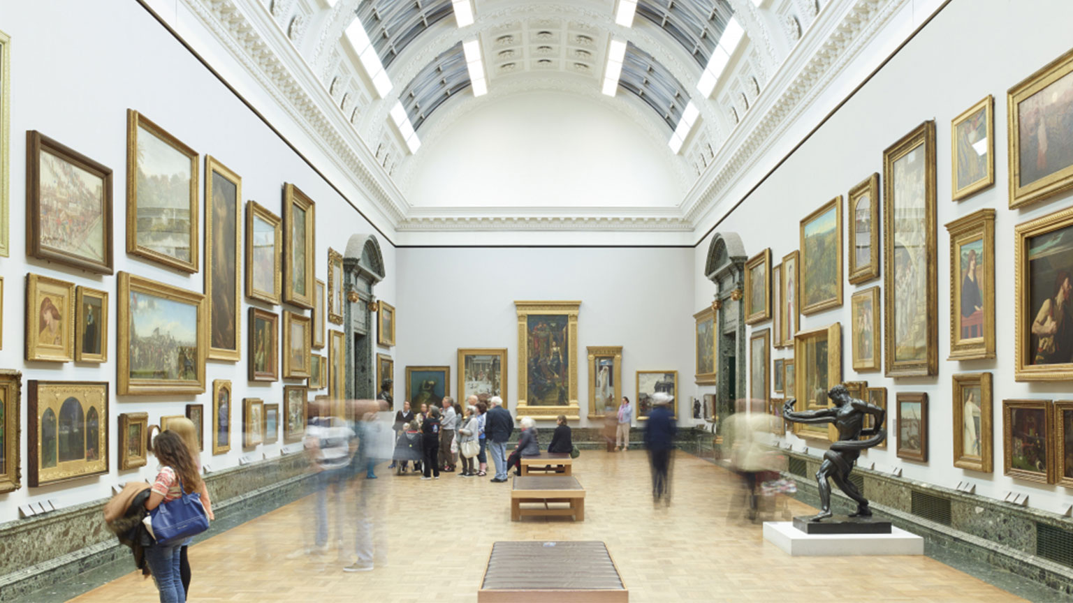
Nicky Phillips
Early Career
After leaving school, she trained at the London Art School before moving to Italy. However, she returned to London a few years later because she wanted to be close to The National Gallery and The Tate art gallery.

Slide 5
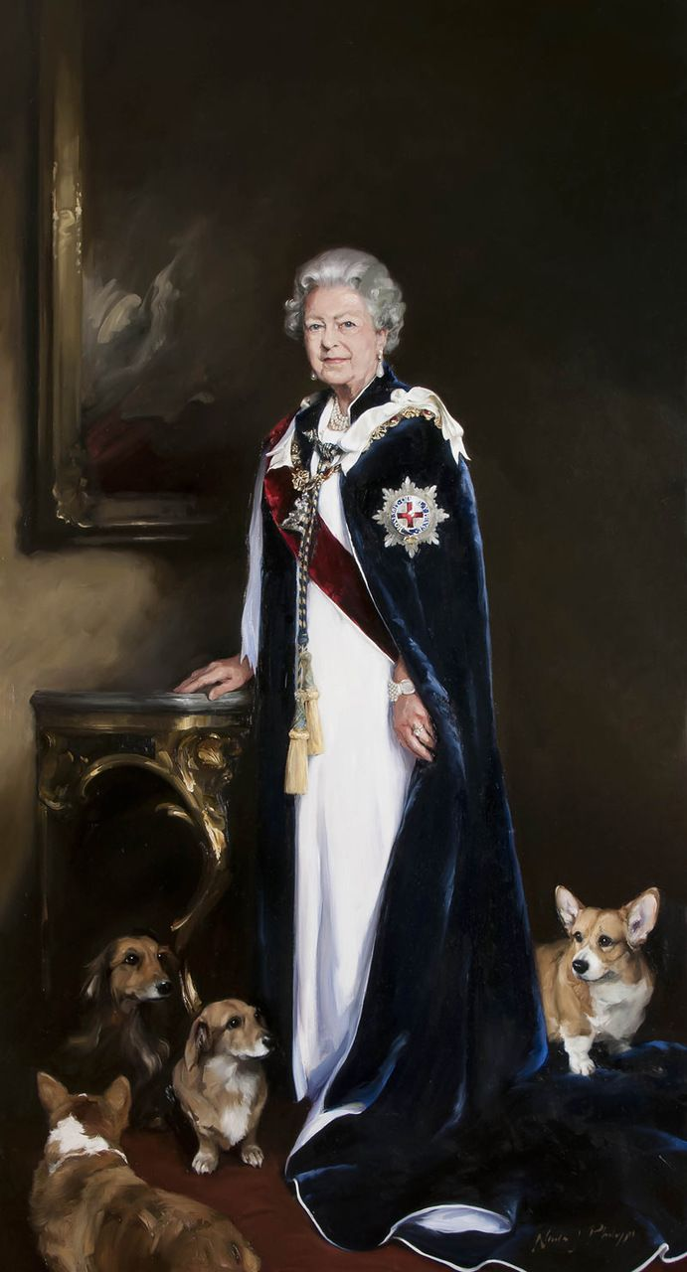
Nicky Phillips
Royal Portraits
In 2010, Nicky Phillips was commissioned to create a double portrait of TRH Princes William and Harry. Then in 2013 Nicky painted a portrait of HM Queen Elizabeth II for to celebrate the 60 years since she became queen. She even included the Queen’s pet corgis in the painting.

