Slide 1
Notes:
Weather is the day-to-day changes that we see happen. So, it can be sunny one day and rainy the next. Is our weather always the same?
Climate is the average weather for a particular place over time. Our climate is not very hot, or very cold, it is mild or temperate. Places around the world can have hot climates, cold climates, tropical (wet and dry) or temperate climates. We are going to look at two very cold parts of the world, and one very hot part.

Slide 2
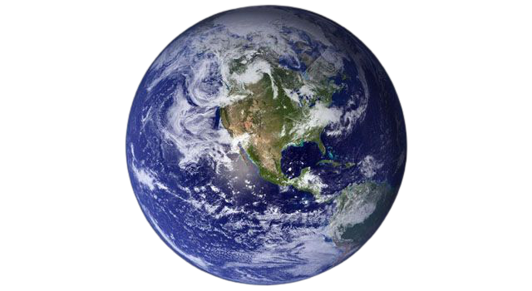
Notes:
Here is our planet, Earth. It is a sphere shape and there are lots of different oceans, continents and countries.

Slide 3
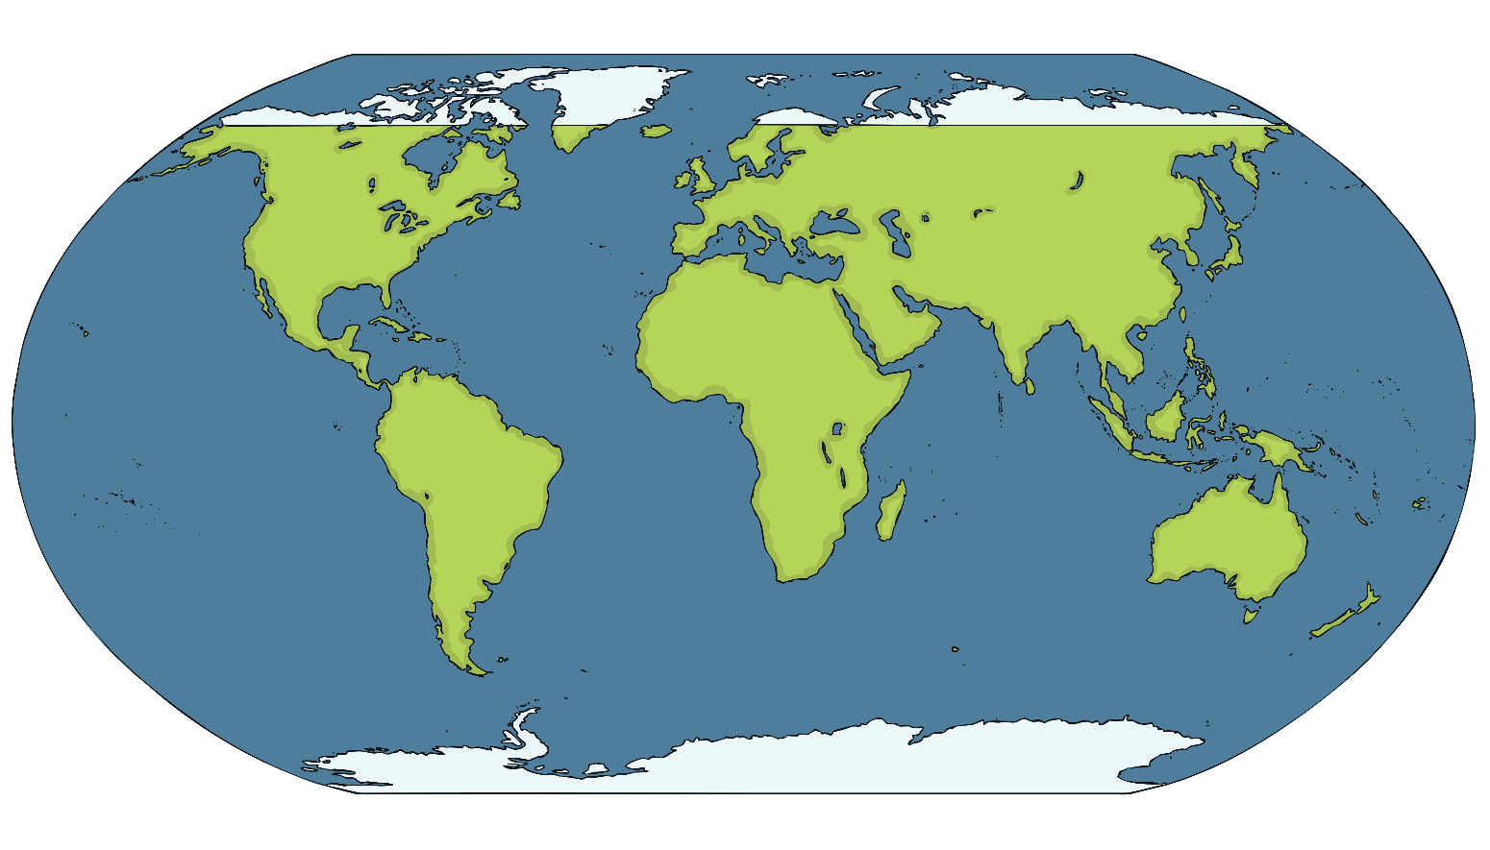
The Arctic
Antarctica
Notes:
The most Northern part of Earth is the North Pole, which is in an area known as ‘The Arctic’. The climate here is cold!

Slide 4
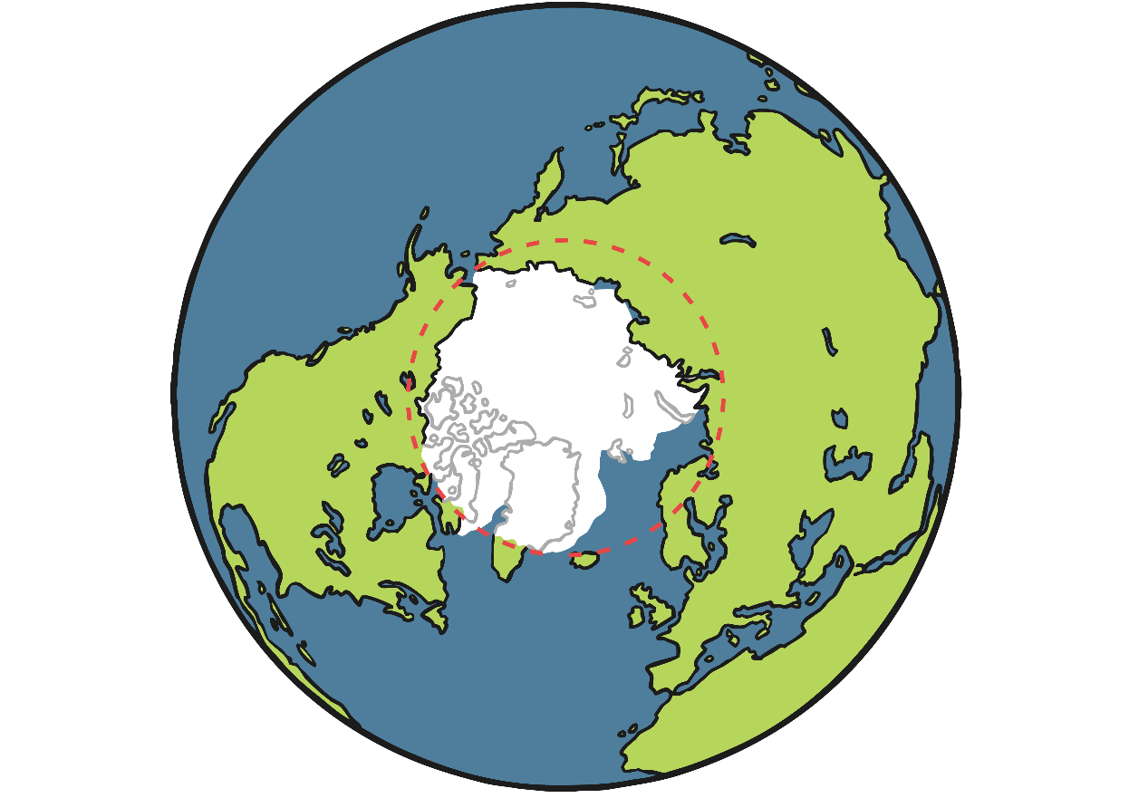
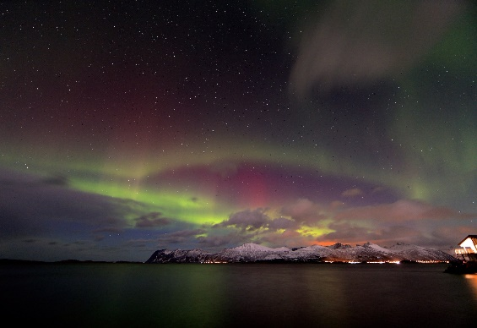
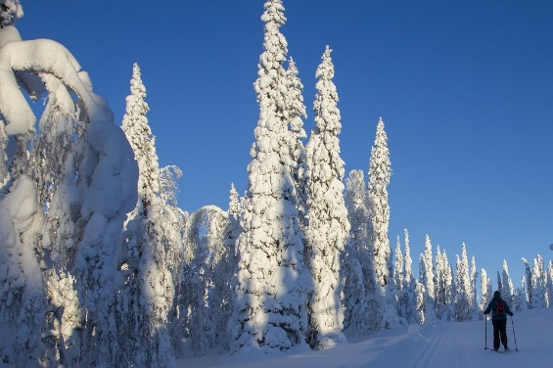
The Arctic
ARCTIC CIRCLE
NORTH POLE
Notes:
The Arctic is at the top of the Earth and it isn’t a country, but rather a whole area called the Arctic Circle. There is lots of frozen ocean and parts of some countries such as Finland, Russia and Canada. The temperature can go from 12 degrees in Summer to -34 degrees in Winter, that’s very cold! In Winter, the sun is so far away from the Arctic that it doesn’t rise at all. Would you like to visit the Arctic?

Slide 5
The Arctic
Antarctica
Notes:
The most Southern part of Earth is the South Pole, which is in an area known as Antarctica. This is the coldest place on Earth, so it’s climate is cold.

Slide 6
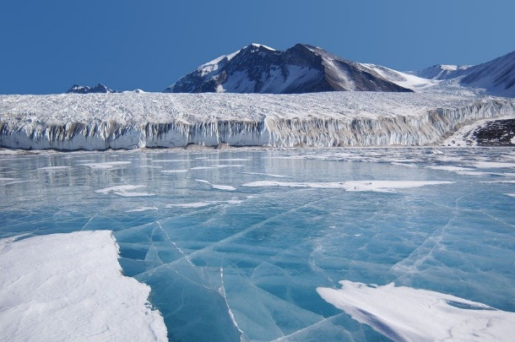
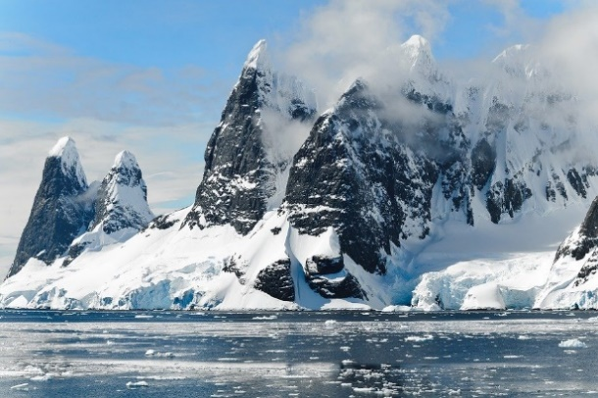
Antarctica
Notes:
Antarctica is the most Southern continent of the world. It is a large area of land, and because it is so cold there, it is always covered in ice. It is the coldest and windiest place on Earth.

Slide 7
The Arctic
Equator
The Equator
Antarctica
Notes:
In between both poles, is the equator. Countries on the equator have hot climates.

Slide 8
The Equator
Notes:
The Equator is an imaginary line around Earth, it is halfway between the North Pole and the South Pole. The Equator line shows the hottest climates in the world.

Slide 9
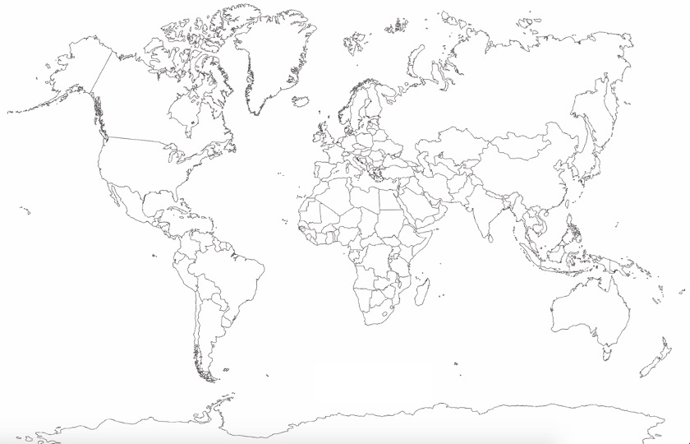
UK
Equator
Notes:
Now we know that the North and South poles of the Earth have cold climates, lets draw a weather symbol there to show it.
I wonder what we could draw to show the hot climate of the equator?

Slide 10
UK
Equator
Notes:
Yes! A sun symbol. Can you see my hot equator line and cold poles? Have a go at drawing it on your map. I wonder what colours you could use to colour those parts of the world in too?

Slide 11
Commentary:
Slide 1: Weather is the day-to-day changes that we see happen. So, it can be sunny one day and rainy the next. Is our weather always the same? Climate is the average weather for a particular place over time. Our climate is not very hot, or very cold, it is mild or temperate. Places around the world can have hot climates, cold climates, tropical (wet and dry) or temperate climates. We are going to look at two very cold parts of the world, and one very hot part.
Slide 2: Here is our planet, Earth. It is a sphere shape and there are lots of different oceans, continents and countries.
Slide 3: The most Northern part of Earth is the North Pole, which is in an area known as ‘The Arctic’. The climate here is cold!
Slide 4: The Arctic is at the top of the Earth and it isn’t a country, but rather a whole area called the Arctic Circle. There is lots of frozen ocean and parts of some countries such as Finland, Russia and Canada. The temperature can go from 12 degrees in Summer to -34 degrees in Winter, that’s very cold! In Winter, the sun is so far away from the Arctic that it doesn’t rise at all. Would you like to visit the Arctic?
Slide 5: The most Southern part of Earth is the South Pole, which is in an area known as Antarctica. This is the coldest place on Earth, so it’s climate is cold.
Slide 6: Antarctica is the most Southern continent of the world. It is a large area of land, and because it is so cold there, it is always covered in ice. It is the coldest and windiest place on Earth.
Slide 7: In between both poles, is the equator. Countries on the equator have hot climates.
Slide 8: The Equator is an imaginary line around Earth, it is halfway between the North Pole and the South Pole. The Equator line shows the hottest climates in the world.
Slide 9: Now we know that the North and South poles of the Earth have cold climates, lets draw a weather symbol there to show it. I wonder what we could draw to show the hot climate of the equator?
Slide 10: Yes! A sun symbol. Can you see my hot equator line and cold poles? Have a go at drawing it on your map. I wonder what colours you could use to colour those parts of the world in too?

