Slide 1

Geography
The seven continents – Revision
The Five Oceans

Slide 2
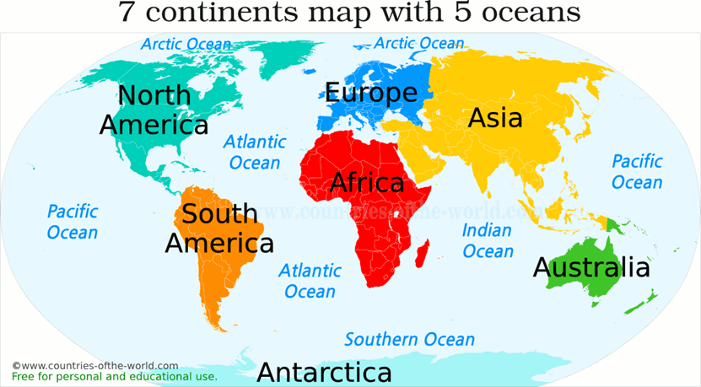
The Seven Continents – Revision
A continent is one of Earth’s seven main divisions of land. There are seven continents on our planet that are Africa, Asia, Antarctica, Europe, North America, and South America and Oceania/Australasia.
In order from largest to smallest by size, they are Asia, Africa, North America, South America, Antarctica, Europe, and Australasia/Oceania.
Antarctica is the coldest continent and Asia is the warmest continent.

Slide 3
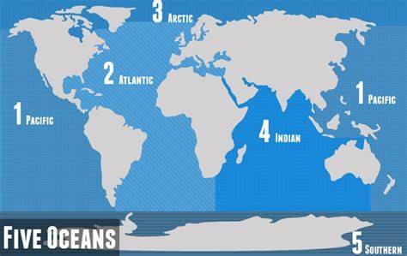
The Five Oceans
There are five oceans that cover just over 70% of our planet, and they are all connected together:
the Atlantic Ocean
the Pacific Ocean
the Indian Ocean
the Southern Ocean
the Arctic Ocean
The nearest ocean to the UK is the Atlantic Ocean. It stretches from Europe to North and South America, and is the second largest of the five oceans.

Slide 4
The water in the oceans is constantly moving in patterns called currents.
Some currents flow quickly, while some move very slowly.
As the currents flow around the planet they move cold and warm water from one place to another, changing climate and temperatures all over the world.
The UK would be much colder if it wasn’t warmed by water that travels from the Caribbean.

