Slide 1
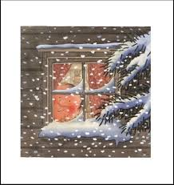
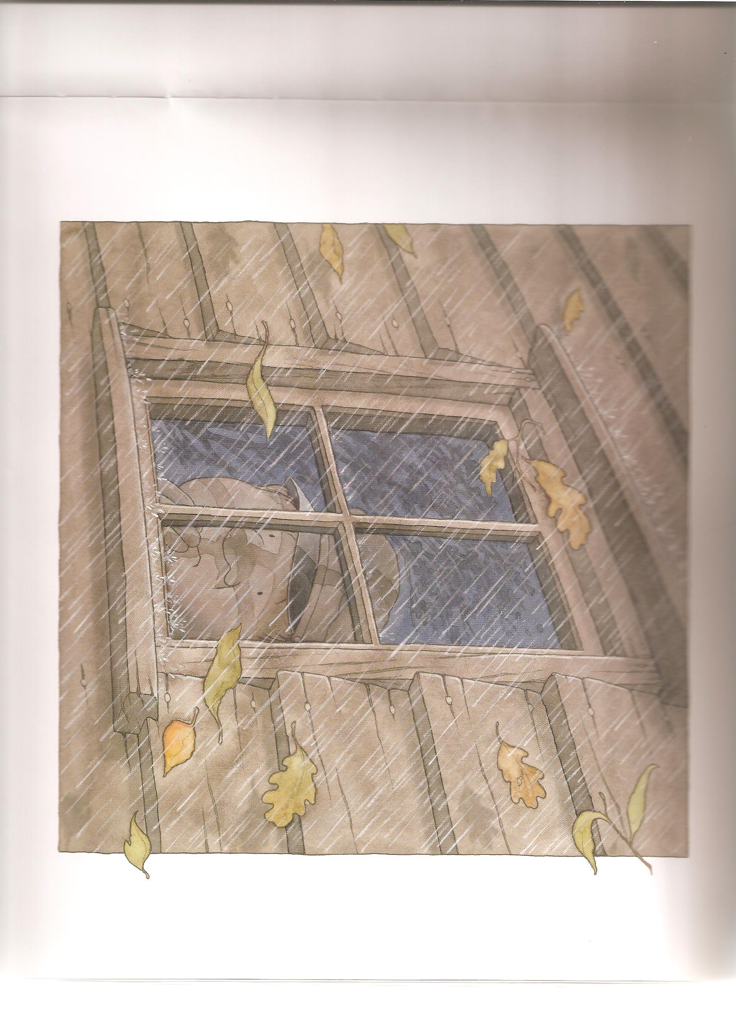
What is the weather like in each picture? Is it the same or different?
How do you think Percy feels?
Why?

Slide 2

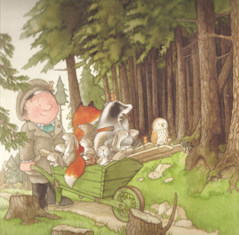
Can you see the same
animals in both pictures?
Are Percy and the animals in
the same setting in both pictures?

Slide 3
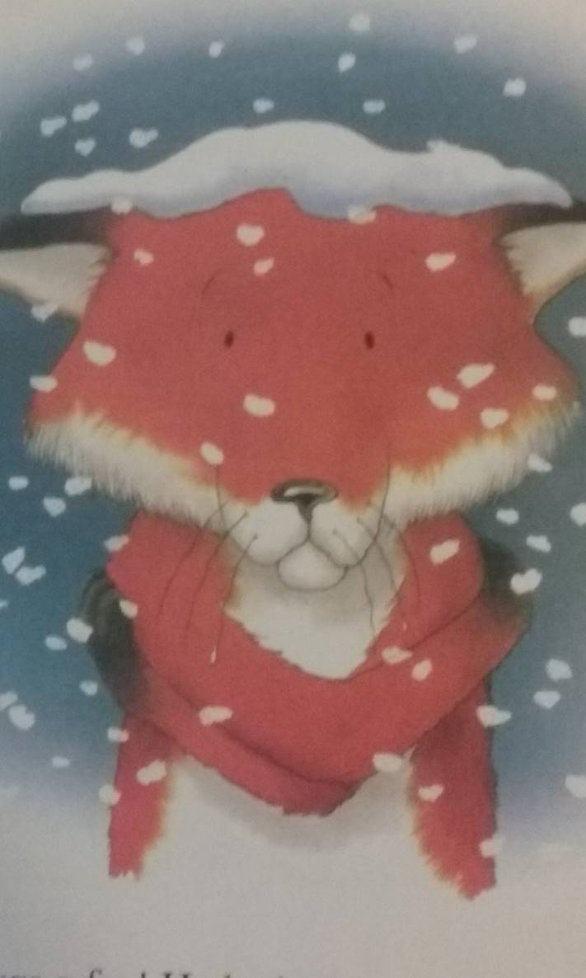
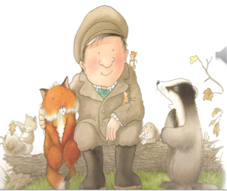
Do the animals look happy or sad?
Why do you think that is?
What do you think the animals are saying to Percy?

