Slide 1
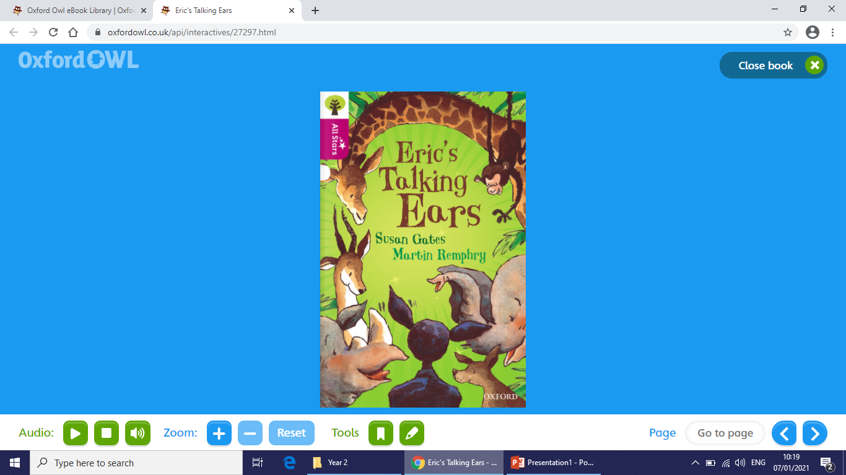
Today we will be reading Eric’s Talking Ears

Slide 2
Today we will be reading Eric’s Talking Ears
How to get to the book
Log in to Oxford Owl using your username and password from your account.
Click on Read Write Inc eBooks Library
Click on Eric’s Talking Ears and click on the arrow to
open the book

Slide 3
Before you begin to read think about some predictions of the story.
. Think about the words ‘talking ears’ in the title. Do ears
usually talk?
. Look at the cover picture. Which character do you think
is Eric?
. Where might this story be set? What gives you that
idea?

Slide 4
Do you know the meaning of these words?
puny
haughty
signalled
timid
trudged

Slide 5
puny - small and weak
haughty - snobbish and unfriendly
signalled - used movements to communicate
timid - shy
trudged - walked slowly and with heavy steps

Slide 6
Question 1
Apart from the cap and ears, what other item does Eric need to use when he’s talking to the animals?

Slide 7
Question 2
What are the names of the animals that speak to Eric?

Slide 8
Question 3
Why do you think the lions were so keen to invite Eric inside their cages?

Slide 9
Question 4
How do the animals feel about Eric once they find out he told the zookeepers about their break-out plan?

Slide 10
Question 5
When Eric first talks to the elephants, they waggle their ears. Can you find any more words that describe how the animals move their ears?

