Slide 1
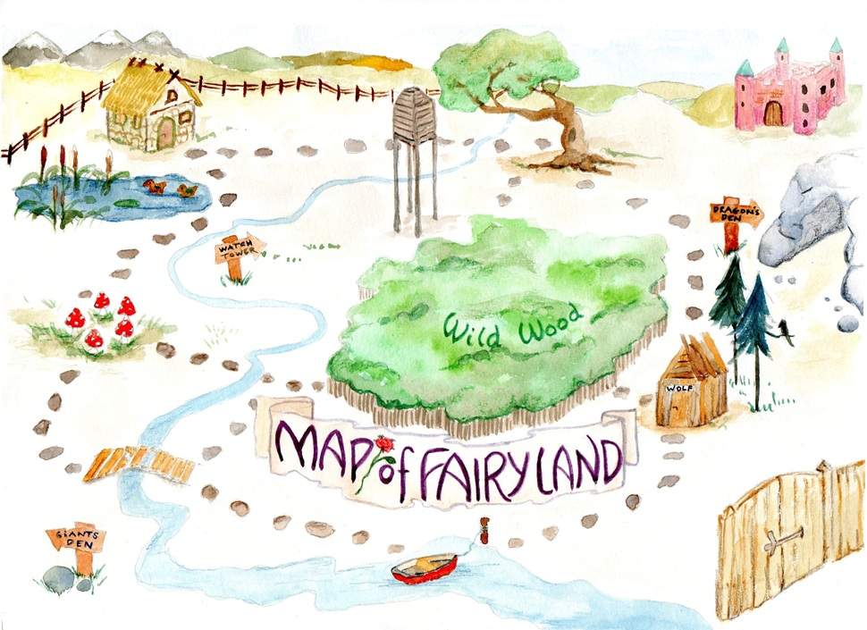
Learning intention: to plan instructions
You are going to be writing instructions for an adventure! What are we telling the reader to do in Fairyland?

Slide 2
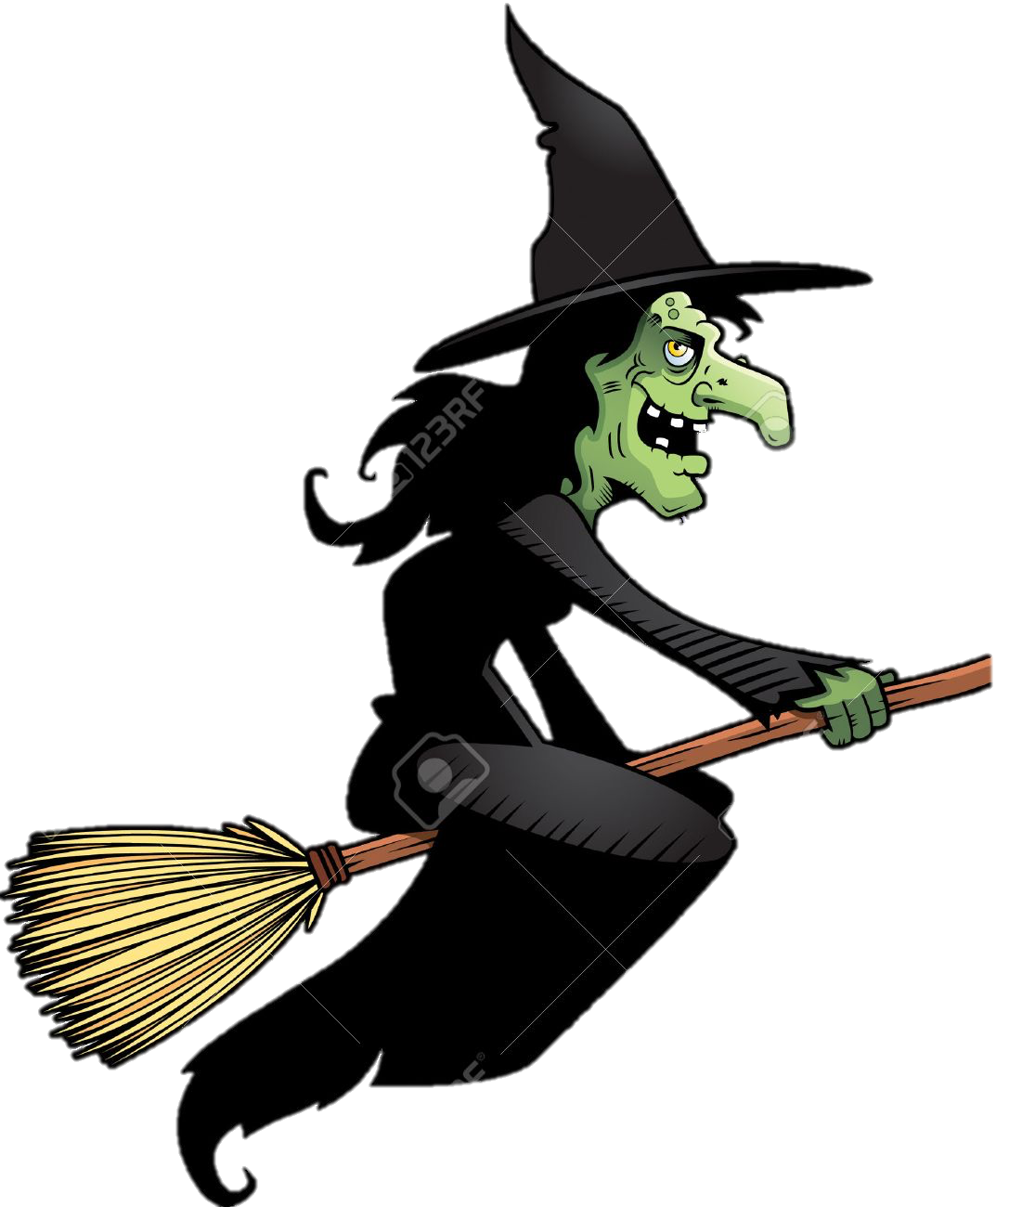
Be bossy! What do I need to do at each place?
witch’s
. . .
path
hut
. .
. . .
ship
. .

Slide 3
I have written the first imperative verb. Can you think of the rest?
witch’s
. . .
Run
path
hut
. .
. . .
ship
. .

Slide 4
Here are my ideas. Did you get the same?
Run
Go
Get
Go

Slide 5
Oral rehearsal. Practice telling someone these instructions! You can also act them out with actions.
witch’s
. . .
Run
path
hut
. .
. . .
Go
Get
Go
ship
. .

