Slide 1
Year 1 History Which house would you find this in?

Slide 2
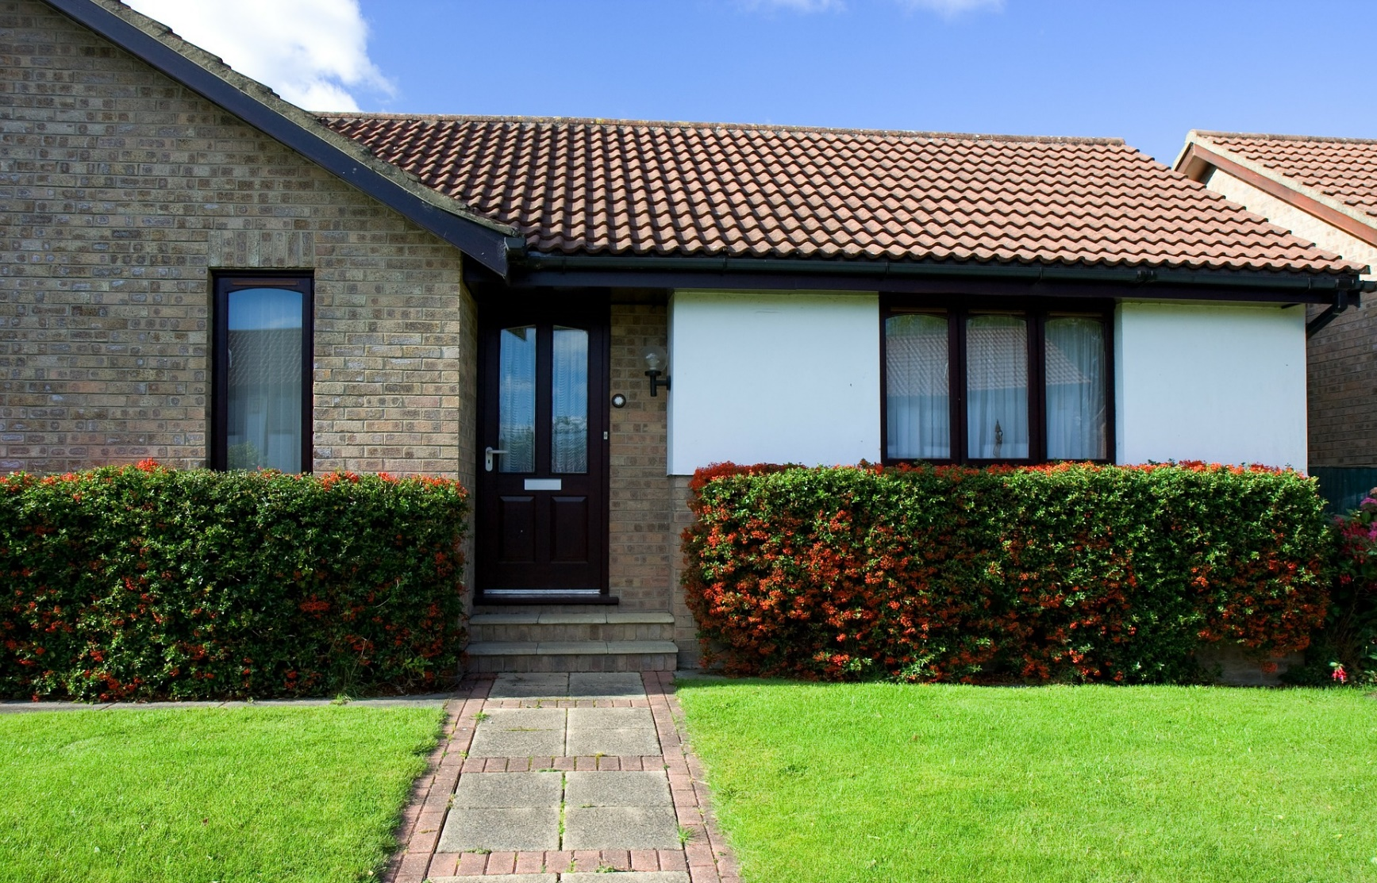
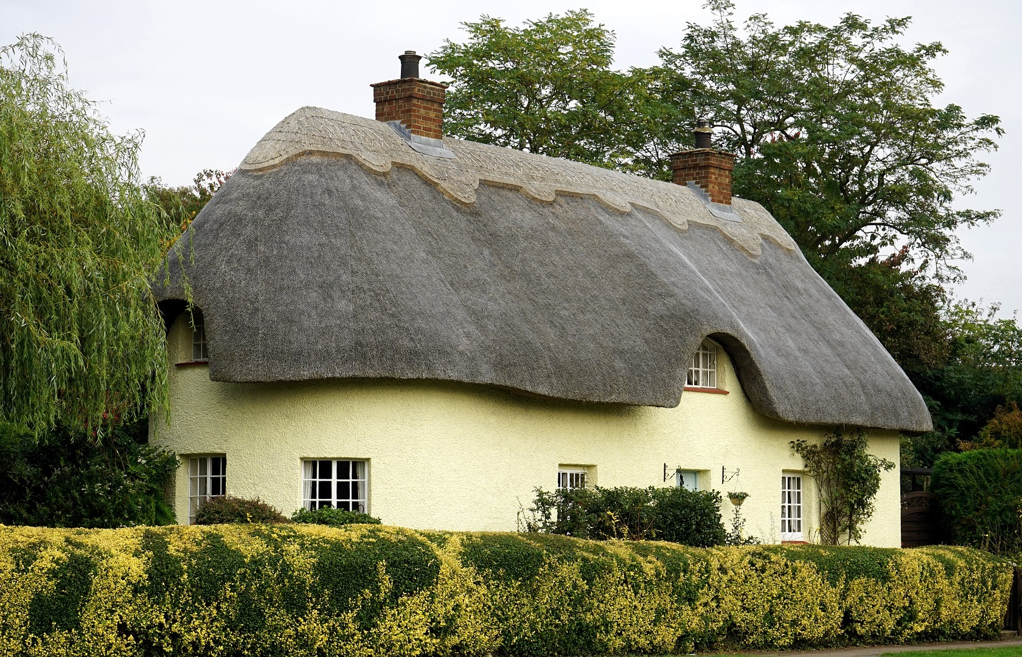
We have been learning about old and new houses. Have a look at these two houses, which one is old and which one is new?

Slide 3
That’s right!
new
old

Slide 4
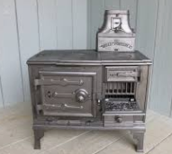
Lets have a look at some things you might find in a house and think about if they are from a house in the past or a house from now.
A cooker. Is this cooker from a house in the past or a house from now?
Why do you think this?

Slide 5
That’s right!
This is a cooker from a house in the past.

Slide 6
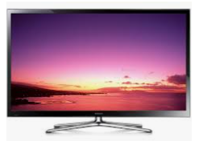
A tv. Would this tv be found in a house from the past or is it from a house from now?
Why do you think this?

Slide 7
That’s right!
This tv would be found in a house from now.

Slide 8
A washing machine. Would this washing machine be found in a house from the past or is it from a house from now?
Why do you think this?

Slide 9
That’s right!
This washing machine would be found in a house from now.

Slide 10
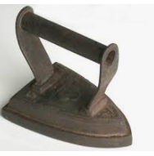
An iron. Would this iron be found in a house from the past or is it from a house from now?
Why do you think this?

Slide 11
That’s right!
This iron would be found in a house from the past.

Slide 12
A kettle. Would this kettle be found in a house from the past or is it from a house from now?
Why do you think this?

Slide 13
That’s right!
This kettle would be found in a house from the past.

Slide 14
A hoover. Would this hoover be found in a house from the past or is it from a house from now?
Why do you think this?

Slide 15
That’s right!
This hoover would be found in a house from now.

Slide 16
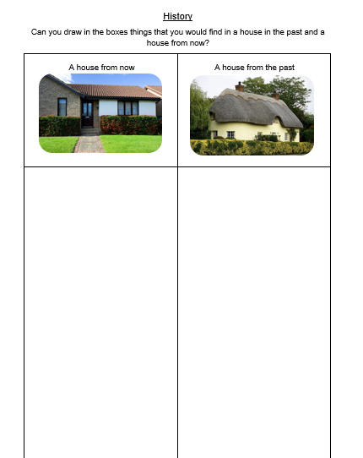
Now have a go at the worksheet.

