Slide 1
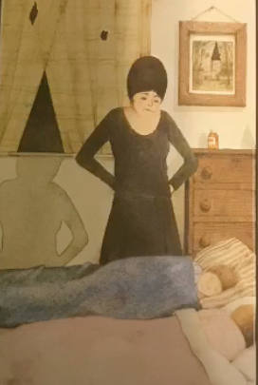
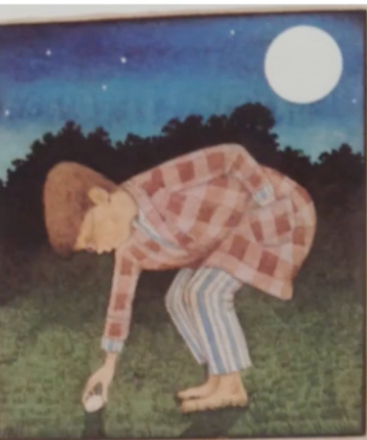
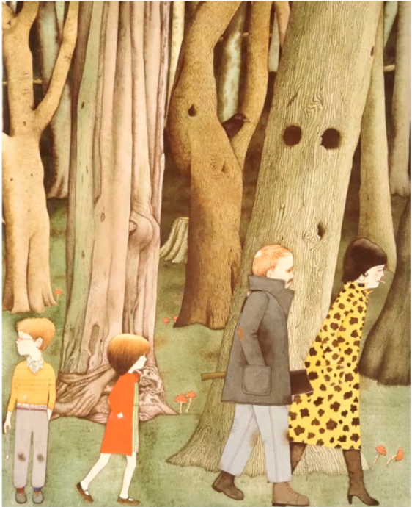
Learning intention: to write a witch story
Today we are writing the beginning of the story.
Remember to use your setting description from yesterday to help you to write your story.
Look at the next slide to see how I used my story map to help me to write the beginning.

Slide 2
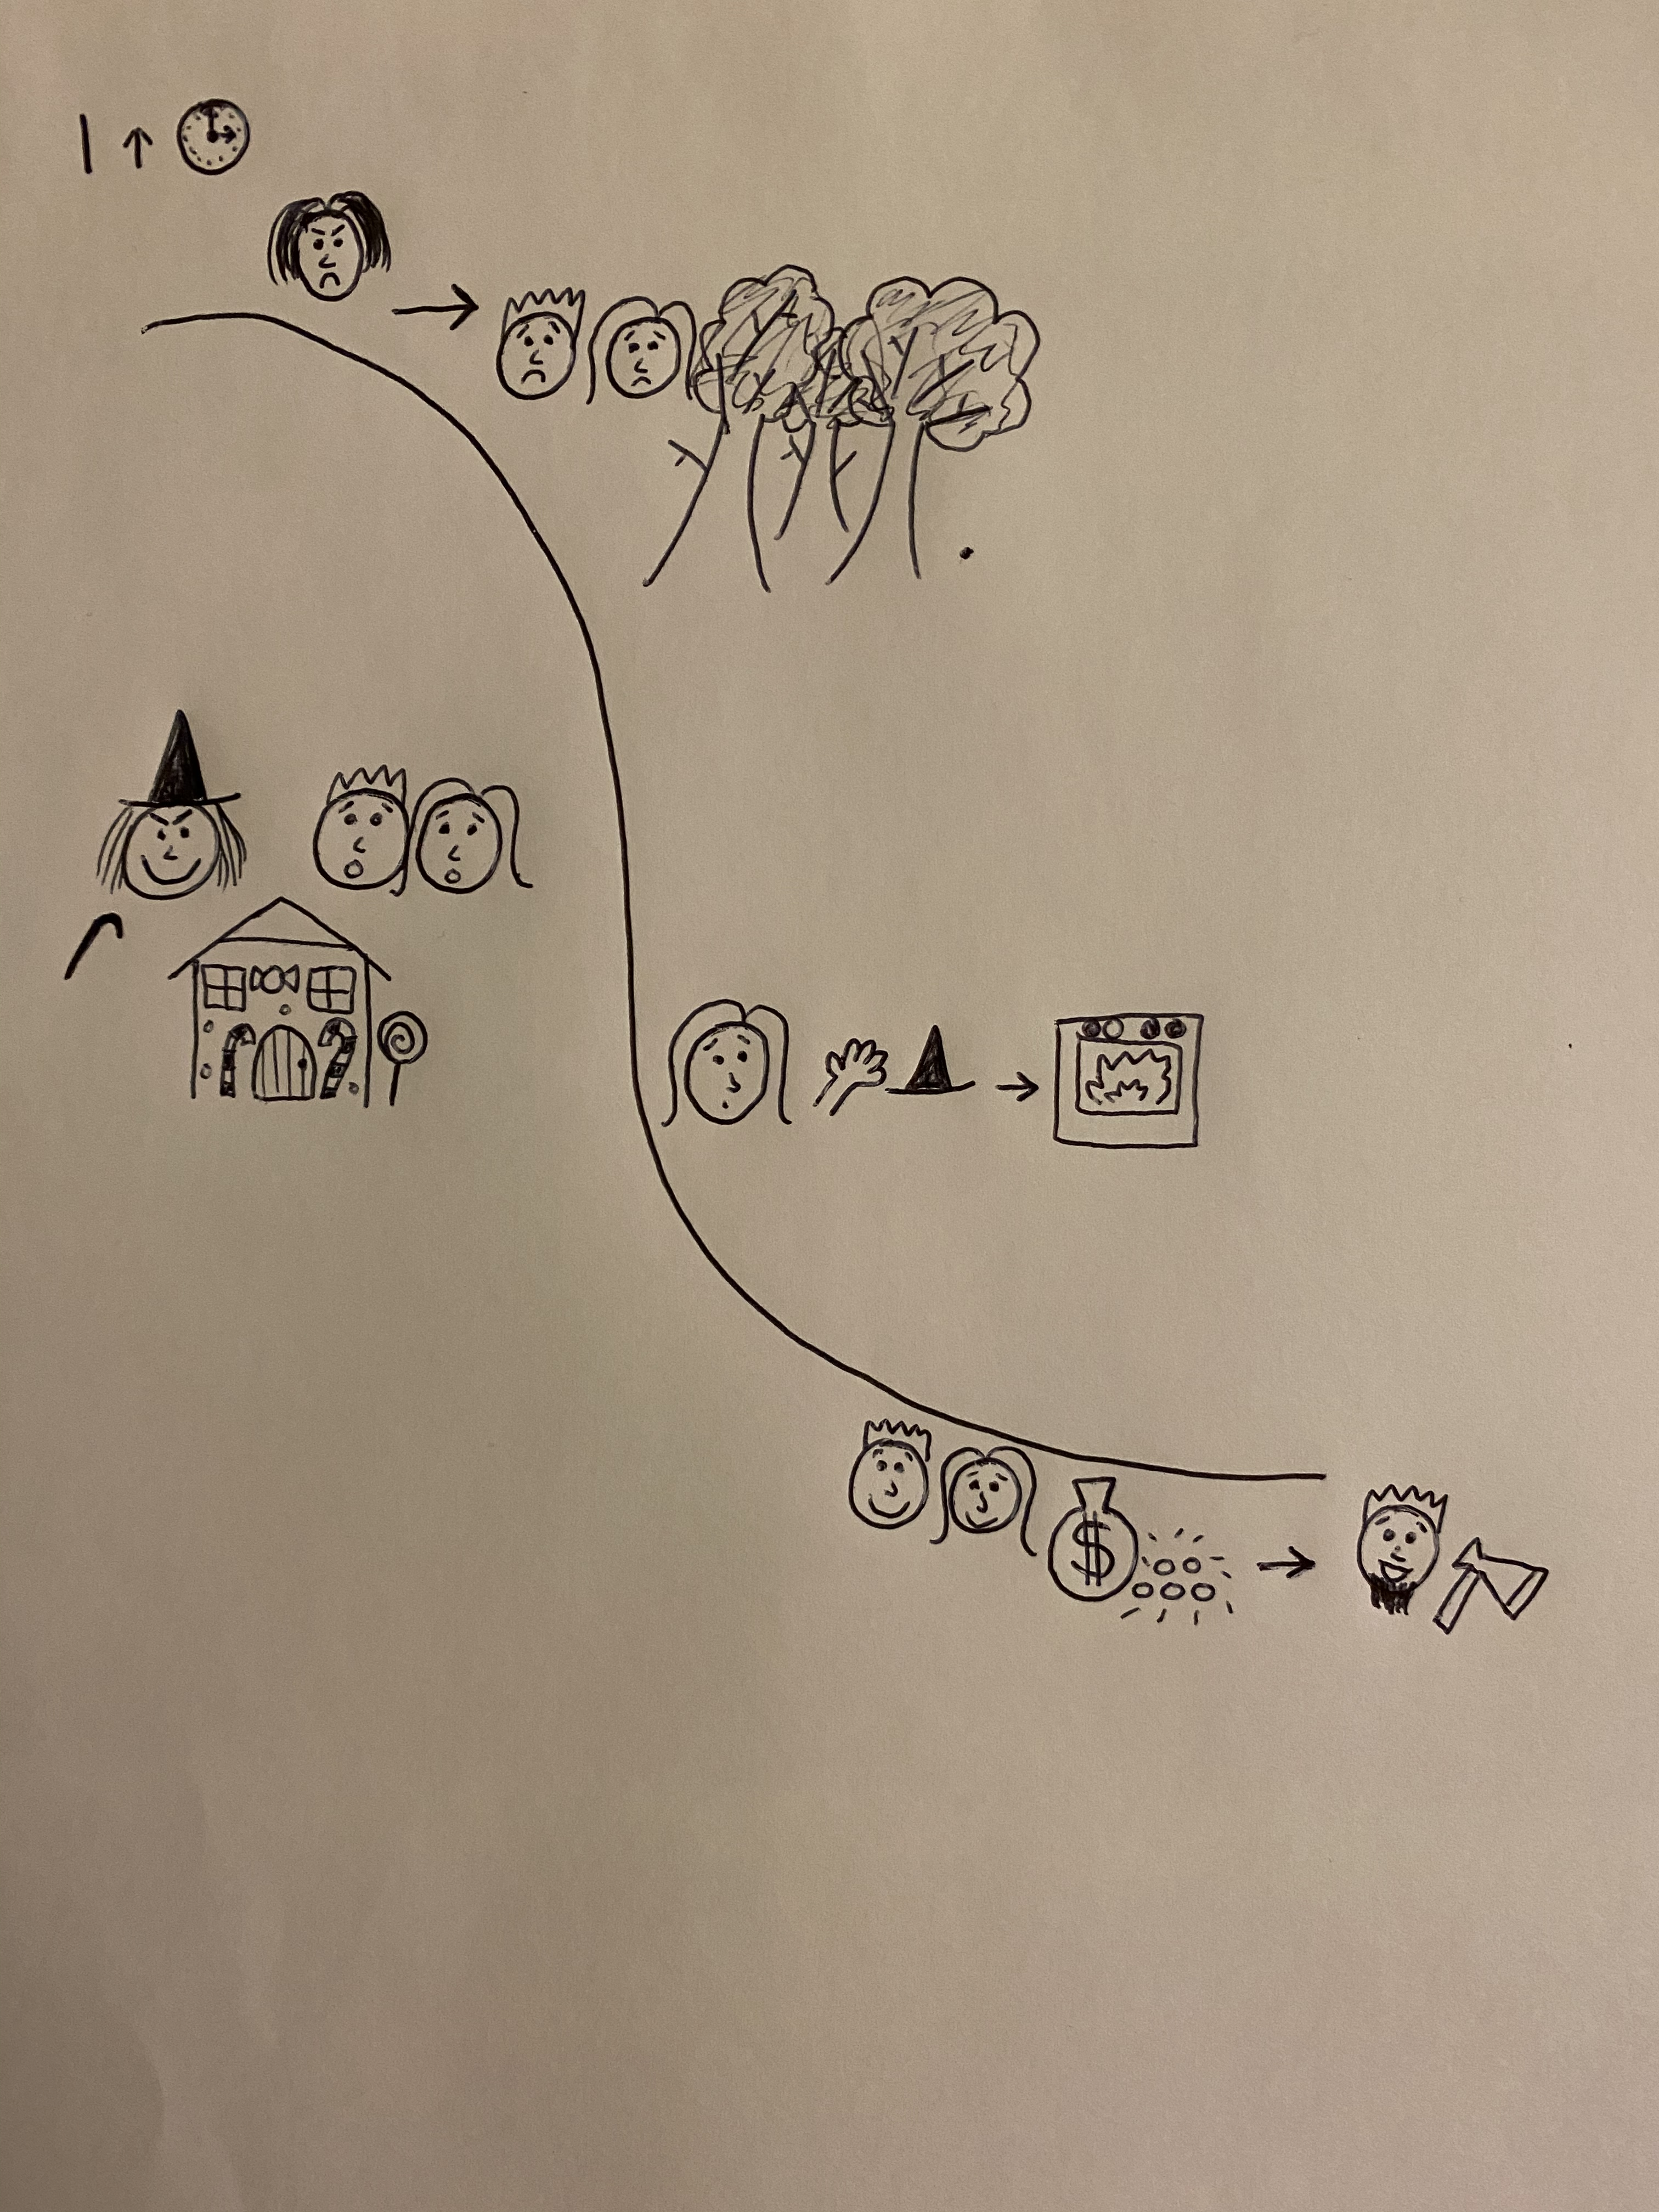
peaceful
My story beginning
freezing
suspicious
towering mountains

Slide 3
Once upon a time there lived two poor, starving children called Hansel and Gretel. Their evil stepmother decided to leave the children on the freezing mountain because she didn’t want to feed them any more. The children were lonely but the mountain felt quite peaceful. Hansel left a trail of pebbles and the children got home safely. The stepmother was not pleased to see them.
peaceful
freezing
suspicious
towering mountains

Slide 4
Can you write a story beginning using your story map and setting vocabulary?
Remember:
Capital letters
Full stops
Conjunctions to extend your sentences (and, or, but, because, when, if, that)

