Slide 1
Today we will be reading this book.
You can find it on Oxford Owl. > ebooks> rwinc> purple level
https://www.oxfordowl.co.uk/api/interactives/29289.html
Read by yourself first then you could listen to the teacher read the story on the PowerPoint.

Slide 2
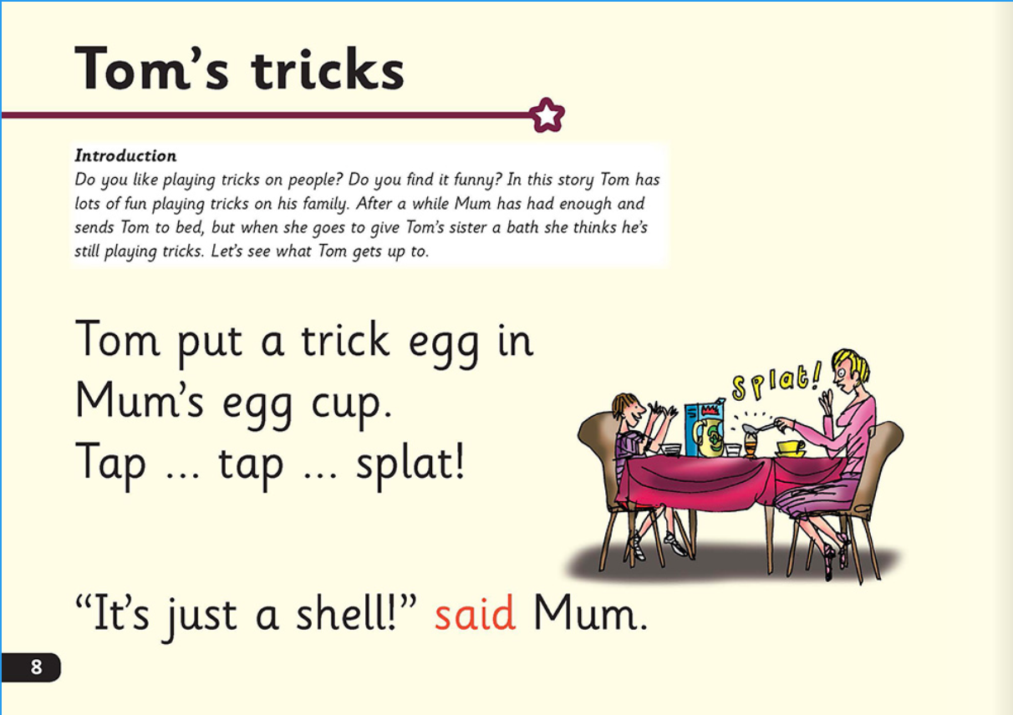

Slide 6
