Slide 1
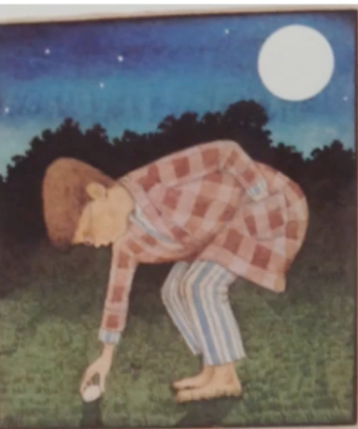
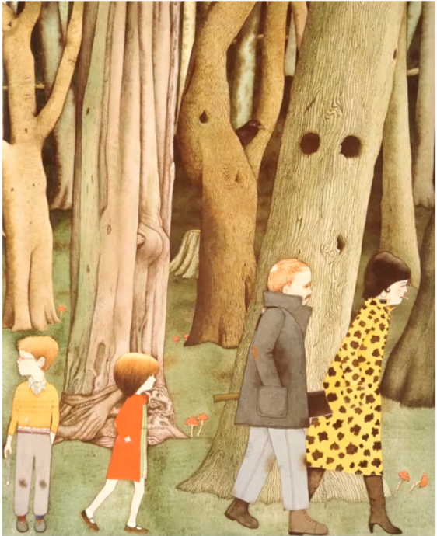
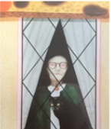
Learning intention: to write a witch story
Think about what happens in the beginning of the story.
What happens in the middle of the story?
What happened at the end?

Slide 2
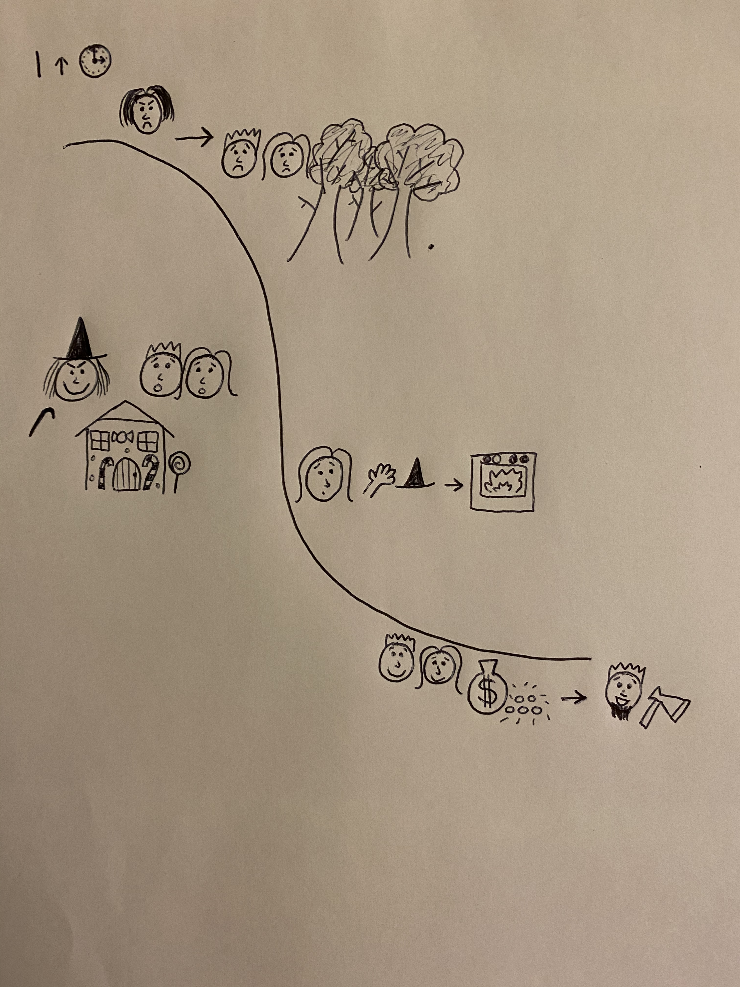
Use the story map and add pictures to show the beginning, middle and end of the story.
Your map might look something like this:
Beginning
Middle
End

