Slide 1
Learning intention: To learn what a verb is.

Slide 2
Verbs are action words. They describe what someone is doing.

Slide 3
What is the verb?

Slide 4
Swim

Slide 5
What is the verb?

Slide 6
Write

Slide 7
What is the verb?

Slide 8
Sleep

Slide 9
What is the verb?

Slide 10
Eat

Slide 11
What is the verb?

Slide 12
Skip

Slide 13
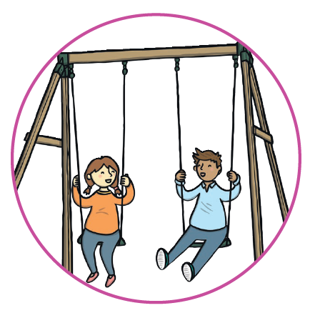
Can you tell your grown up what these verbs are?

Slide 14
The answers
sit
read
wave
swing
jump

