Slide 1
Learning intention: To understand the ‘x’ and ‘÷’ symbols.

Slide 2
Making Groups
Pasha and Anna are making groups.
Anna makes 3 groups of 5.
Pasha makes 5 groups of 3.

Slide 3
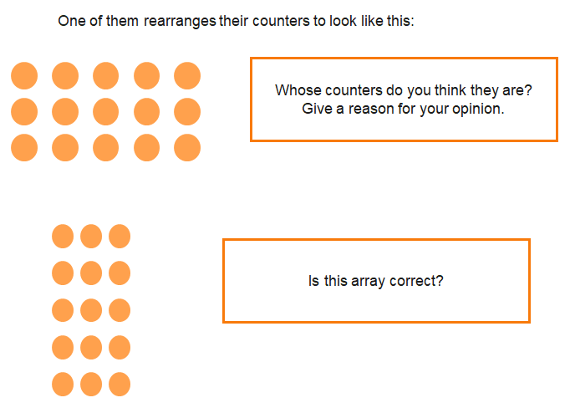

Slide 4
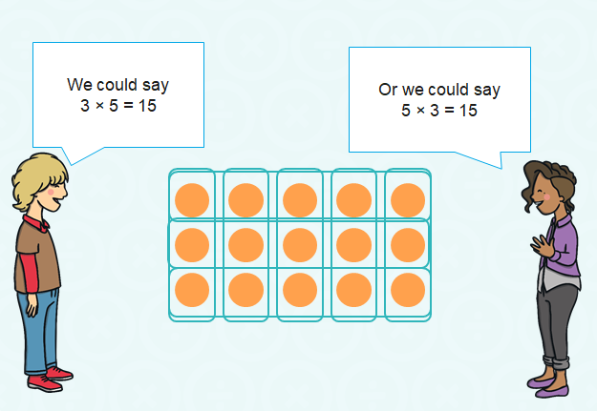
We can multiply in any order. It is commutative.

Slide 9
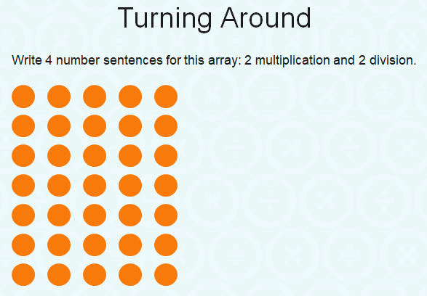

Slide 10
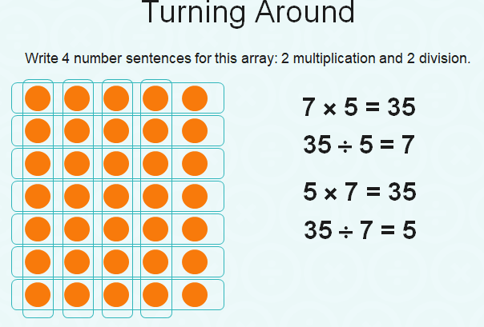

Slide 11
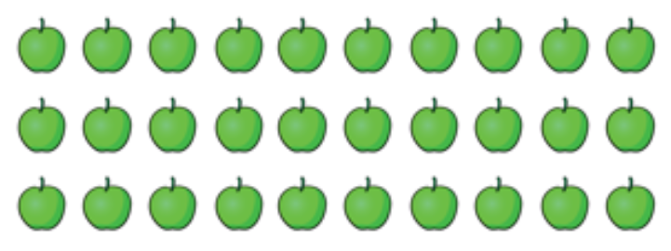
Write the 4 number sentences for this array.
2 multiplication and 2 division.

Slide 12
Write the 4 number sentences for this array.
2 multiplication and 2 division.
3 x 10 = 30
10 x 3 = 30
30 ÷ 10 = 3
30 ÷ 3 = 10

Slide 13
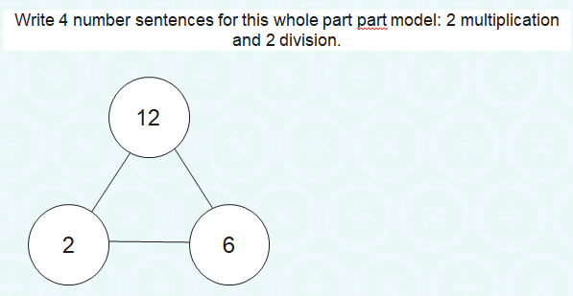

Slide 14
