Slide 1
Learning Intention
To write my own narrative poem

Slide 2

Your own narrative poem
Using the comic strip you made yesterday, you are going to make a simple, narrative poem.
Have a look at mine on the next slide to see how.
All I have done is taken what the characters said and wrote this in to inverted commas (speech marks)

Slide 3
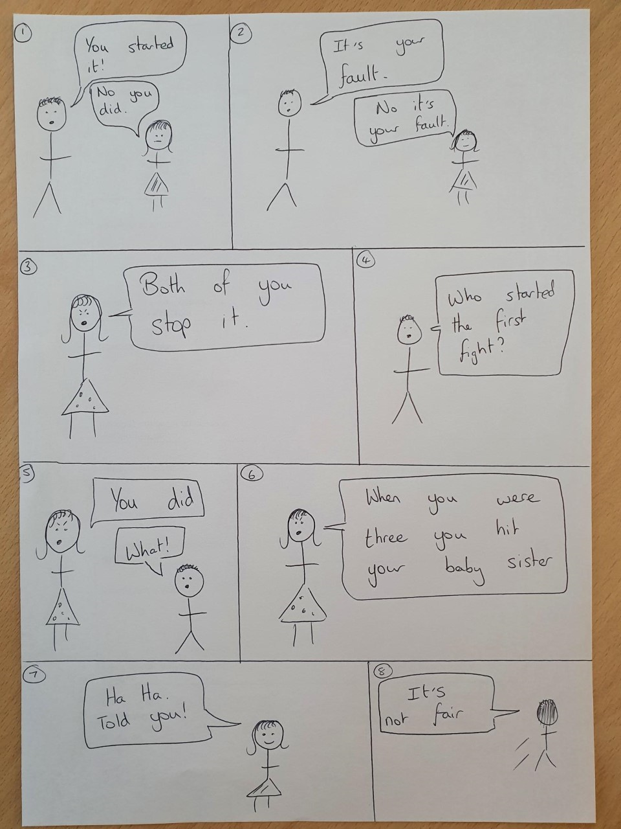
Me and my sister were arguing.
“You started it,” I said
“No you did,” She said
“It’s your fault.” I said
“No it’s your fault,” She said
“Both of you stop it” Mum shouted
Can you see how I have started a new line for each character talking and missed a line for each new box.

Slide 4
Your task
Like my example on the last slide, I want you to make up your own simple poem by taking what your characters said in the comic strip and write it down with inverted commas (speech marks).
Take your time and use my example to help you.

