Slide 1
To understand how the human and physical features of East London have changed over time.

Slide 2
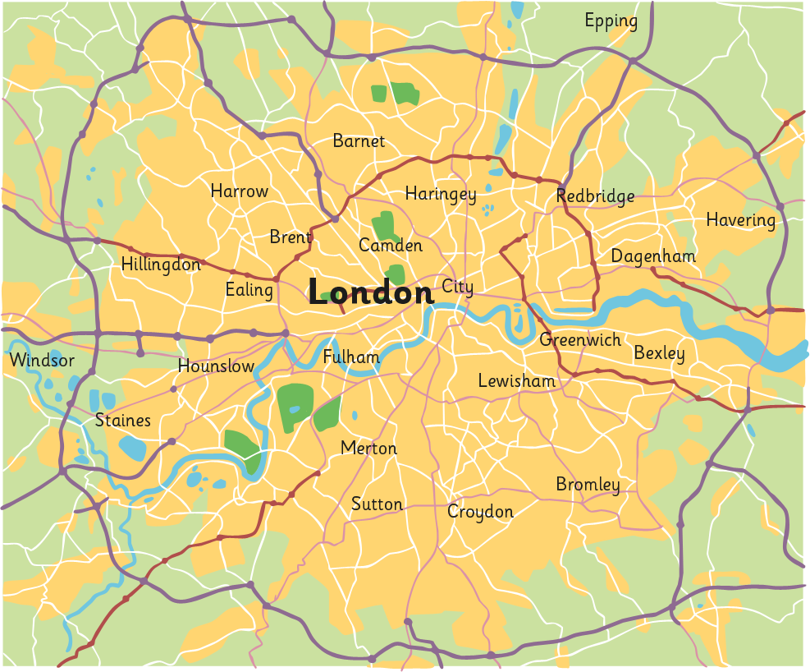
Where Is London?
M25
River Thames
Greater London
City of London

Slide 3
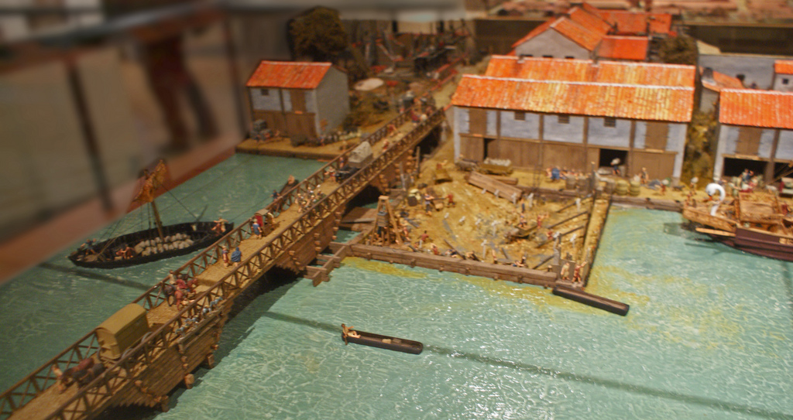
Who Built London?
The Romans invaded Britain in AD 43 and built a settlement called Londinium on the banks of the River Thames.
By AD100, Londinium was the new capital city of Britain and had a population of around 60 000 people!

Slide 4
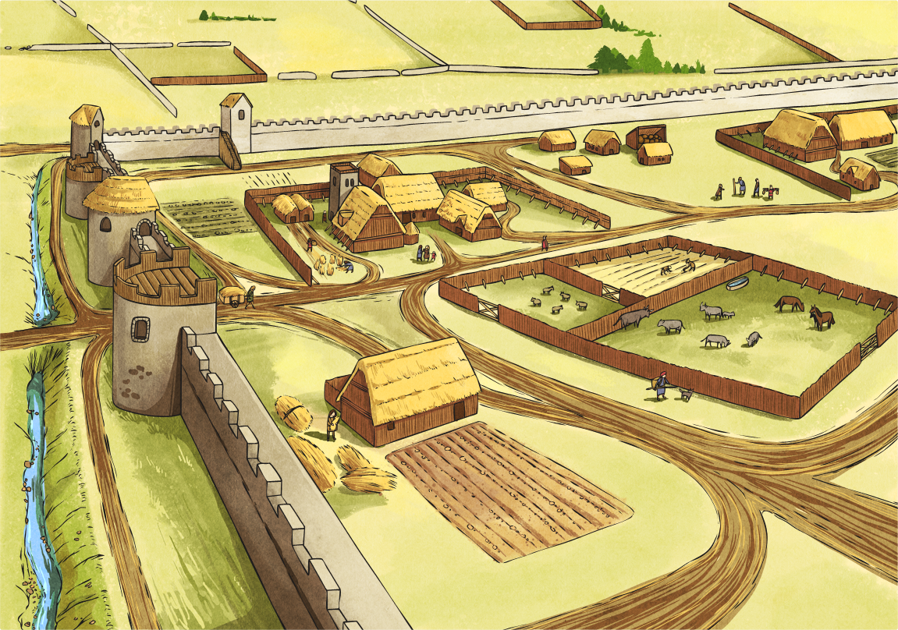
How Did London Change?
After the Romans left in AD 410, an Anglo-Saxon settlement called Lundenwic was built. 15,000 people lived there..

Slide 5
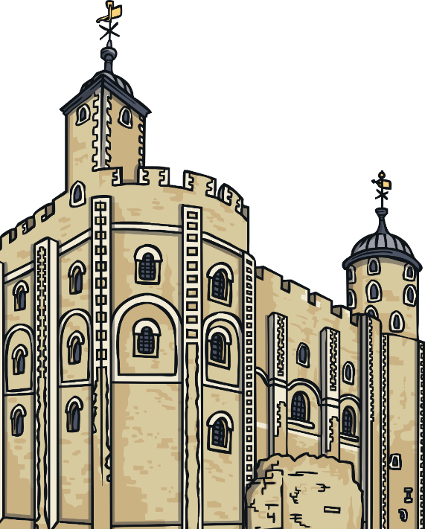
How Did London Change?
After the Norman Invasion of AD 1066, many forts were built, including the Tower of London. 80,000 people lived there
Between AD 1485 and AD 1603 London grew to 225,000 people.
People came from all over the word to live and work there.

Slide 6
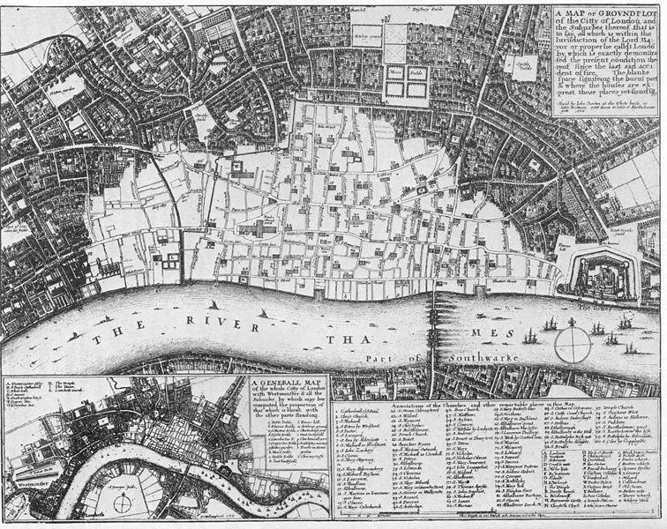
?
Can you remember what happened in London in AD 1666?
In the Great Fire of London, over 60% of the city was destroyed (shown in white on the map).

Slide 7
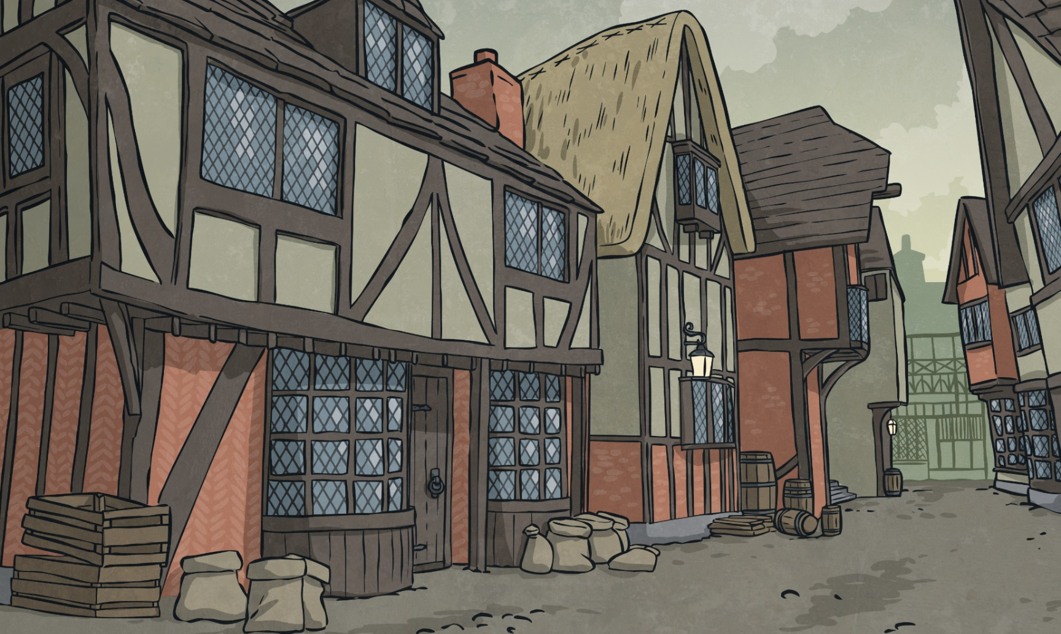
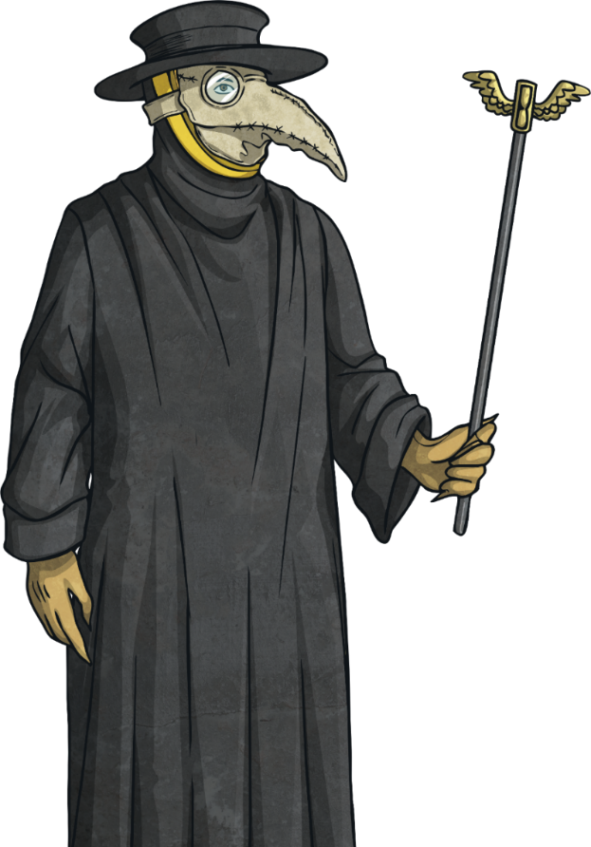
How Did London Change?
The year before the Great Fire, over 60 000 people died because of the Great Plague.

Slide 8
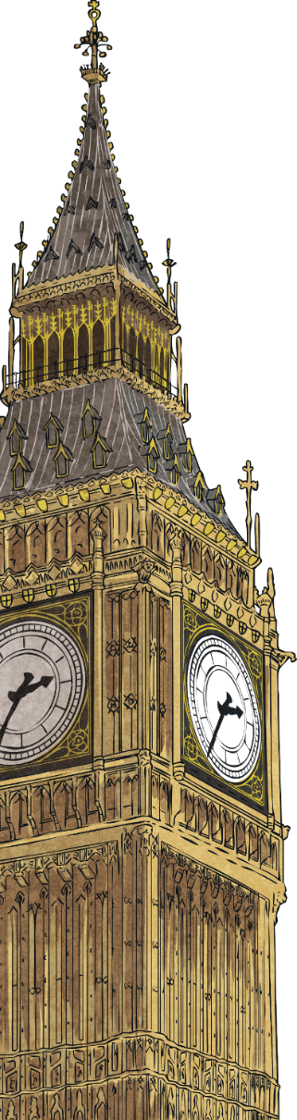
How Did London Change?
More people moved to London and the population rose to 6.7 million.
London grew bigger as new areas of housing were built.
Railways linked London to other parts of the UK.
Landmarks such as Trafalgar Square, Big Ben, the Royal Albert Hall and Tower Bridge were built.

Slide 9
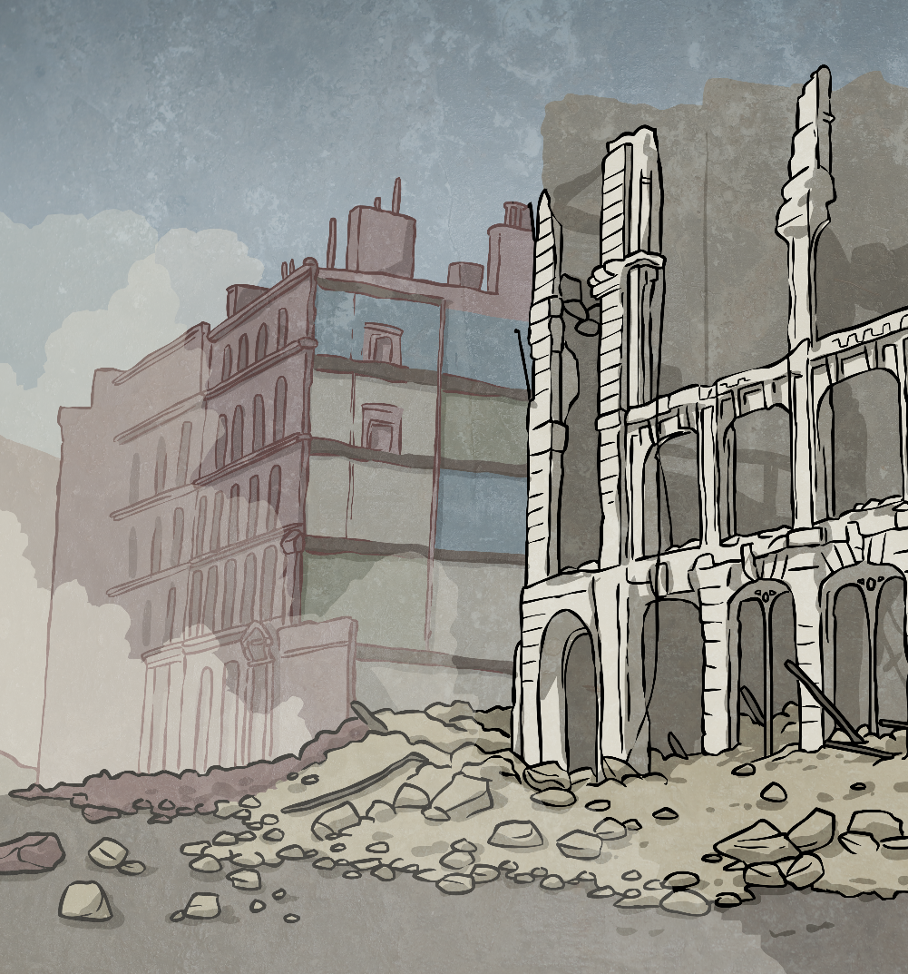
How Did London Change?
After the war ended, high-rise flats were built to replace the destroyed houses.
During the Second World War, areas of London were bombed and many houses and other buildings were destroyed.

Slide 10
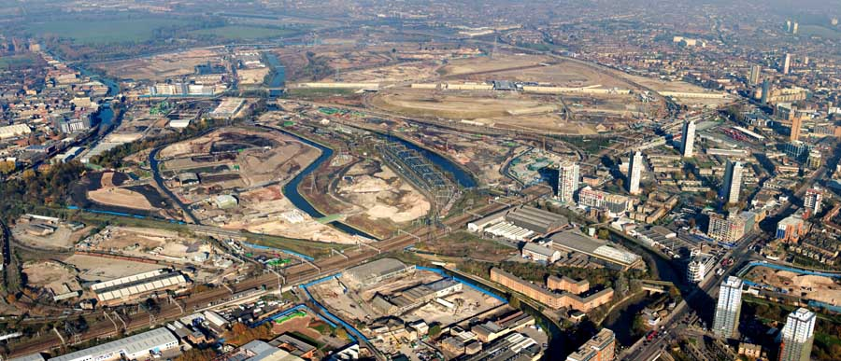
Now it’s your turn
This is an area of London called East London in 2008.
What human and physical features can you see?

Slide 11
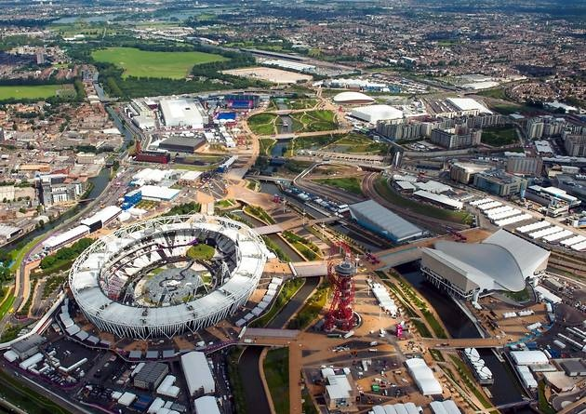
Now it’s your turn
This is the same area of London but in 2012. It was transformed ahead of the Olympic Games.
What human and physical differences can you see?

Slide 12
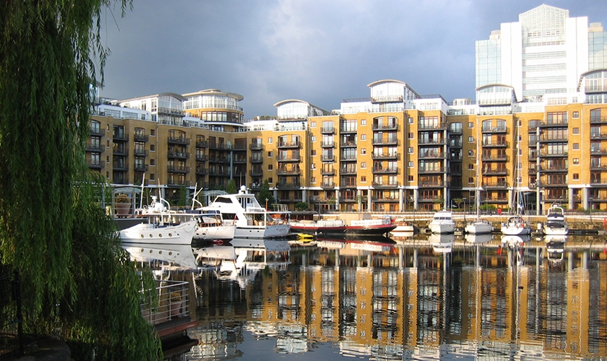
How has the area changed?
What do you think has happened to the population of this area?

