Slide 1

To talk about story settings and how they make us feel.
A setting is where and when a story is set. For example, in a forest, in a castle, at school or in space

Slide 2

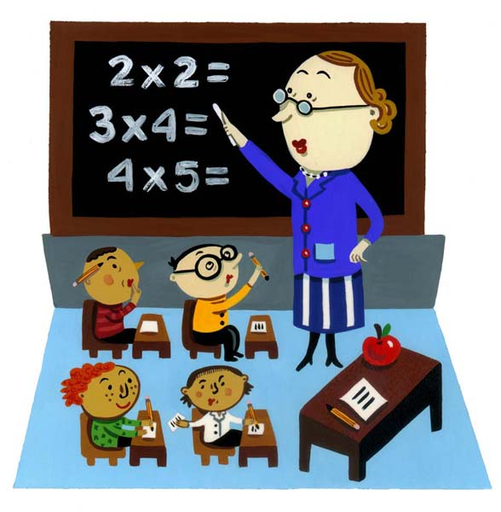
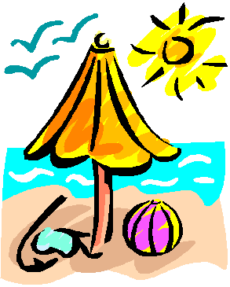
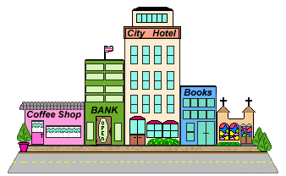
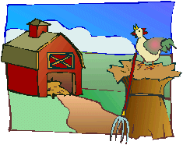
These are some examples of settings
Playground space rocket classroom beach
Look at some of your story books. Think about where the story is set.
Does the setting change in the story?
City Farm

Slide 3
These are some words that you might use when describing settings. Can you think of any more you could add?
how something might look
beautiful
old
new
ugly
enormous
tiny
crowded
empty
dark
bright
dull
colourful
spooky
Some words to describe smells
fresh
disgusting
damp
fruity
smoky
unusual
Words to describe feelings
happy
worried
excited
scared
terrified
disappointed
lonely
upset
miserable
nervous
Some words to describe sounds
noisy
banging
singing
loud
howling
whispering
shouting
quiet
peaceful

Slide 4
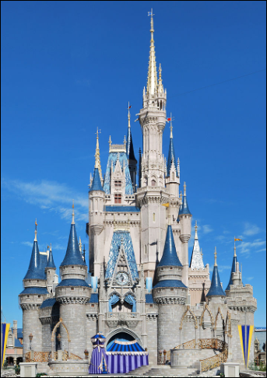
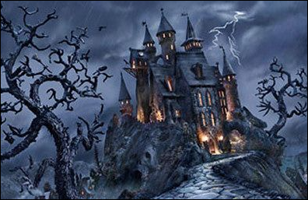
A story could be set in a castle.
Do all castles look the same? Will they smell the same? Will you feel the same in all castles?
Look at these two pictures. Talk to an adult about what you can see in the pictures. How do they make you feel?

Slide 5
This castle looks very dark.
The sky is black and stormy and I can see a bolt of lightning. How does this make you feel? The trees have no leaves, the branches look like fingers. This reminds me of castles I have seen in haunted scary stories. I really don’t feel brave enough to go into this castle.
I think this castle might be like one used in fairy stories. It is clean and colourful. The sky is bright blue. People are usually happy when it is sunny.
I would like to go inside this castle.

Slide 6
We can look at the illustrations in books to learn about the settings or look for clues in the text.
The author helps us understand the story by writing about senses.
What can you hear?
What can you see?
What can you touch?
What can you smell?
How does it make you feel?
.

Slide 7
Which description best describes this picture? Explain your reasons to an adult.
1
It was a warm, bright summers day. Fred skipped along the path towards the castle. The birds were chirping in the trees and butterflies fluttered around the sweet smelling flowers. He could hear people laughing and singing. The delicious smell of freshly cooked biscuits filled the air and made Fred hungry.
2
The wind was strong and the heavy rain hit the path. Fred was shivering because he was so cold. He slowly crept towards the huge, dark, stone castle. The branches on the old tree creaked. Fred could smell the smoke coming from the chimney on the roof. Suddenly, there was a loud bang and a flash of lightening.

Slide 8
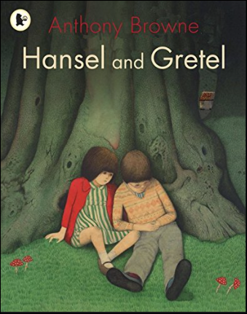
Let’s think about the story of Hansel and Gretel. There are different versions of the story and they have different illustrations. This is the version we have been looking at.
The front cover gives us clues about where the story is going to be set and what type of story it might be.
Talk to an adult about what you can see and explain how it makes you feel.
I thought the story might be sad because the colours are very dark, gloomy and dull. It doesn’t look a very cheerful or exciting front cover.
The children are miserable and it made me think this could be a sad story. When I looked closely at the tree trunk I could see pictures of ghost faces and it even looked as though a dinosaur was about to bite the boy’s head.

Slide 9
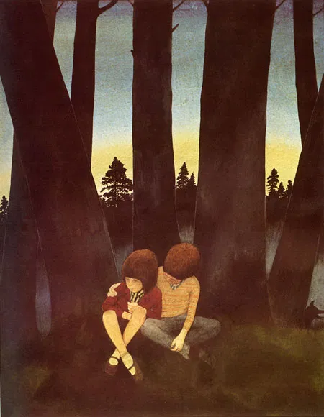

Talk about these two settings with an adult. These are some of the words you might use. Can you describe the setting using your own words?
dark
bright
happy
Sad
scary
Colourful
Smell flowers
Warm
cold

Slide 10
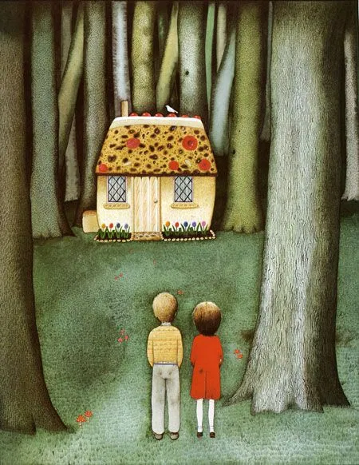
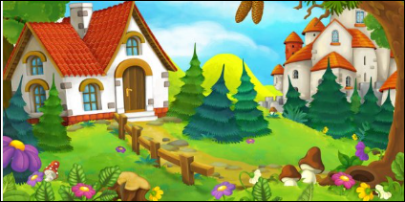
Talk about these two settings with an adult. These are some of the words you might use. Can you describe the setting using your own words?
dark
bright
happy
Sad
scary
colourful
smell flowers
warm
cold

