Slide 1
Learning Intention
To use information from different sources to answer questions

Slide 2
Key Vocabulary
Evidence Proof that something has happened or existed
Archaeology It is the study of things that people made, used and left behind

Slide 3
Recap our learning from last week
King Vortigern invited two Saxon brothers, called Hengist and Horsa to help them in their battles against the Picts.
They were worried that the Picts would take over the Anglo Saxon kingdoms as they were great fighters .
What historical evidence is there to prove these ideas?

Slide 4
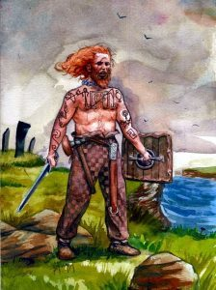
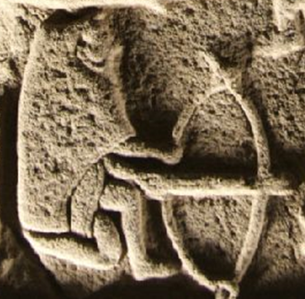
Were the Picts great fighters who could take over the seven kingdoms?
Claudius, a Roman man said in his diary
‘they had blue tattoos and were to be afraid of’
This is a fortress where lived in by the Picts.
Why might it be a good place to live if you needed to fight?
What can you see on these stone carvings?

Slide 5
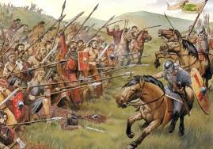
A battle site 685AD where the Picts waited for their enemies to arrive.
What do these stone carvings tell us about the Picts as fighters?

Slide 6
Now it’s your turn
Can you work with someone at home to look carefully again at our question. Talk about the question together and find evidence to support what you think.
Were the Picts great fighters who could take over the seven kingdoms?
Can you explain why you think this? The pictures will help you.
I believe the Picts were great fighters because they had many weapons. In the stone carvings I can see of large swords and shields.

