Slide 1
Statistics Interpreting Bar Charts

Slide 2
What is statistics?
Statistics is collecting and presenting data, usually in the form of graphs.
What is a bar chart?
A bar chart shows data in the form of a graph using rectangular bars.

Slide 3
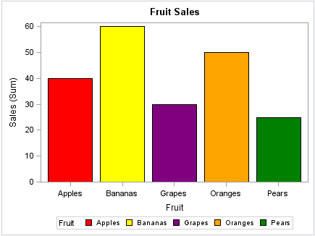
Bar Chart
This bar chart shows how much fruit was sold.
The vertical line (at the side of the graph) shows the amount sold. This is known as the y axis.
The horizontal line (across the bottom of the graph) shows the items that were sold. This is known as the x axis.
If you look at the red bar, it shows us that 40 apples were sold.

Slide 4
Bar Chart
Look at the bar chart.
Can you see how many oranges were sold?

Slide 5
Bar Chart
The orange bar shows how many oranges were sold.
If you look closely, the bar is in line with the number 50. Therefore, 50 oranges were sold.
Now answer the questions on the worksheet.

