Slide 1
Today we are going to look at different sized objects
small
medium
big

Slide 2
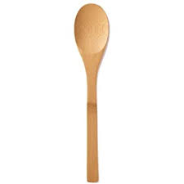
Spoons
medium
big
small

Slide 3
Can you find 1 small spoon and show someone in your house
small

Slide 4
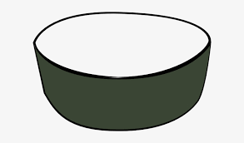
Bowls
big
medium
small

Slide 5
Can you find 2 big bowls and show someone in your house
big

Slide 6
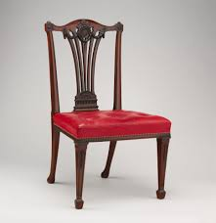
Chairs
small
medium
big

Slide 7
Can you find 3 medium chairs and show someone in your house
medium

Slide 8
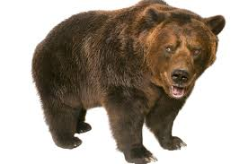
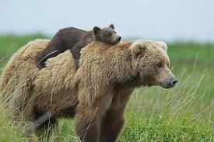
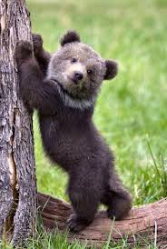
Some bears are big, medium and small
big
medium
small

Slide 9
Can you find 1 small bear or toy and show someone in your house
small

Slide 10
Hope you have had fun looking for things that are different sizes. Big, medium and small.

