Slide 1
Water cycle

Slide 2
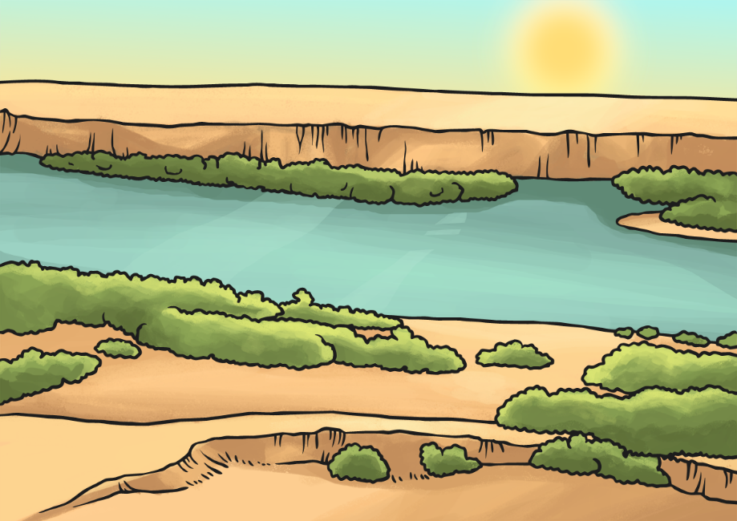
What is the water cycle?
The water cycle is the name we give to describe the way water moves throughout planet Earth. The water cycle has two other names:
The hydrological cycle
The H₂O cycle

Slide 3
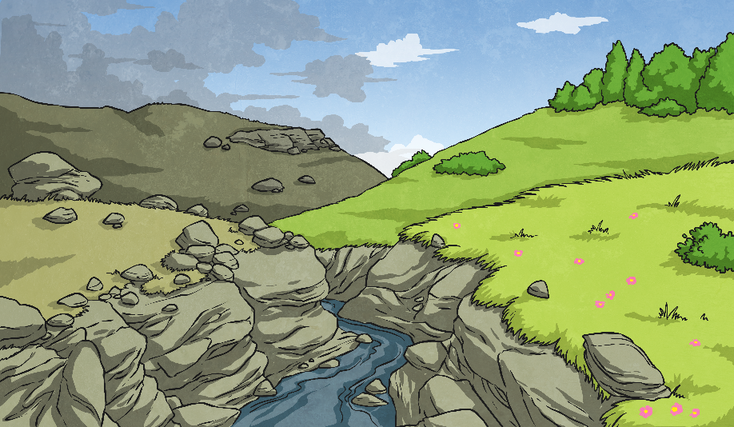
How does the water move in a cycle?
The water cycle has four main parts. These are the steps the water goes through when it’s moving through the Earth:
Evaporation
Condensation
Precipitation
Accumulation

Slide 4
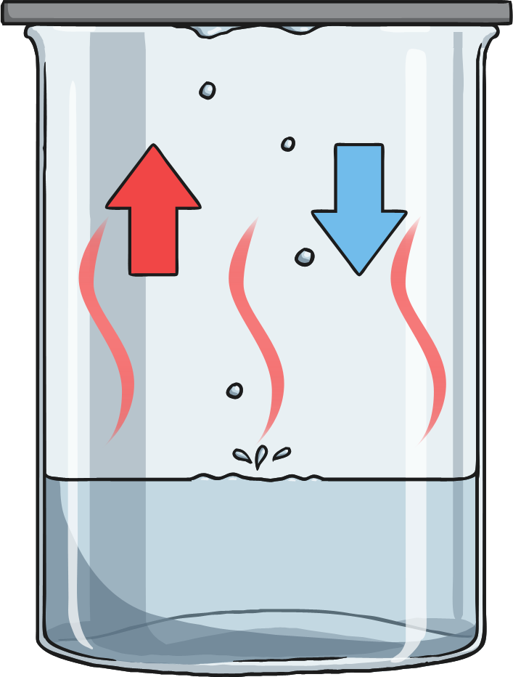
What is evaporation?
This happens when bodies of water like lakes, rivers, and oceans heat up. When the water becomes hot, it forms vapors that go into the air.
You might have seen evaporation if you’ve ever boiled water. The water heats up and then the steam rises from the water!

Slide 5
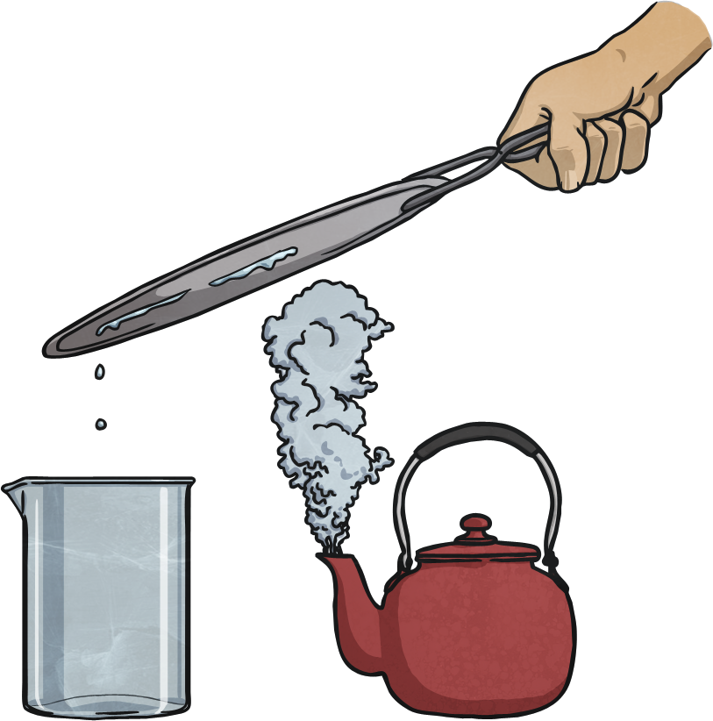
What is condensation
This is the opposite of evaporation. Condensation happens when the vapor in the air gets cold.
When the vapour gets cold, it gets transformed back into a liquid form; this is what makes clouds!

Slide 6
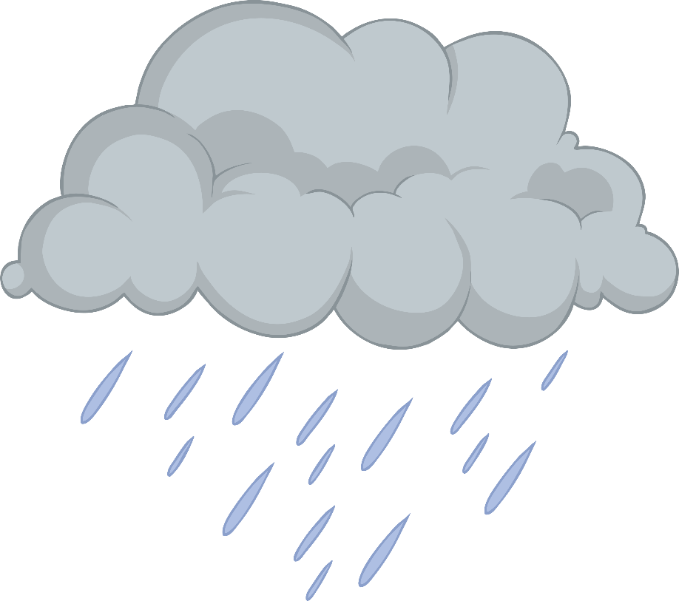
What is precipitation?
Precipitation happens when the water that went up into the sky gets released. Depending on the temperature, the water comes down as liquid or solid.
Rain: when the water comes down as a liquid.
Snow: when the water comes down as a solid.

Slide 7
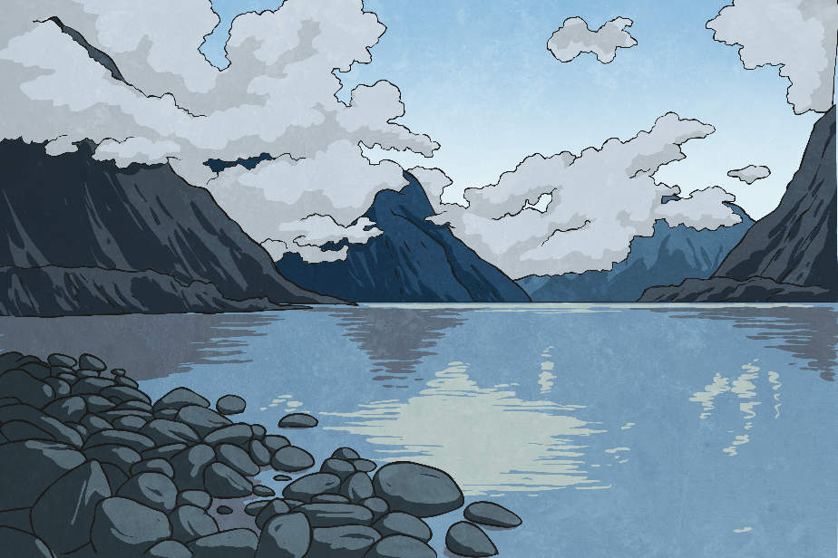
What is accumulation?
This happens when the water collects in one place and forms a river, lake, or any other body of water!
Question: What do you think happens after the water accumulates?
Answer: Evaporation

Slide 8
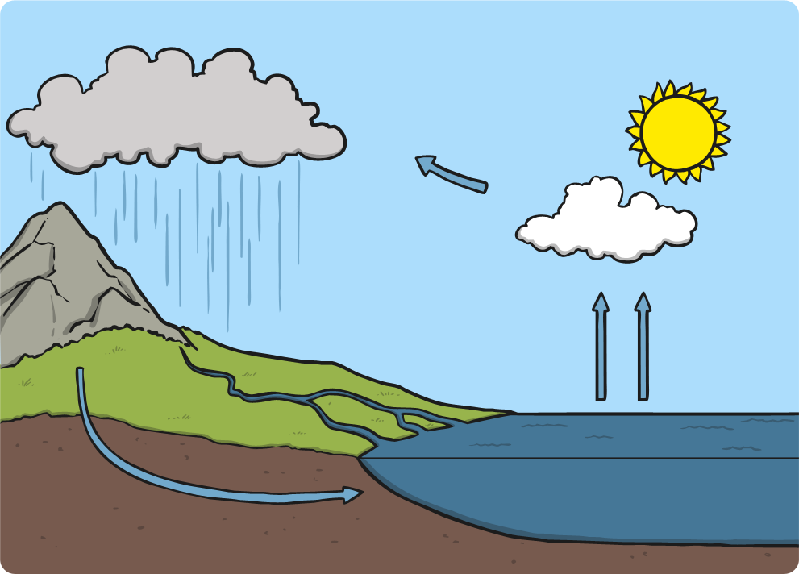
The Water Cycle

