Slide 1
PSHE
LO: To develop strategies to resolve disputes and conflict through negotiation and appropriate compromise

Slide 2
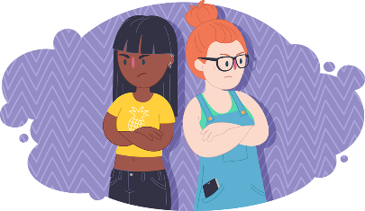
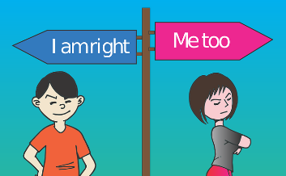
Disputes and conflict
A dispute or a conflict is an argument or disagreement because people want different things.

Slide 3
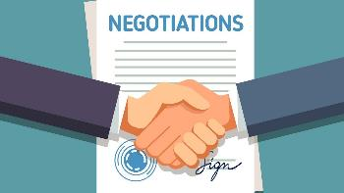
Negotiation
Negotiation is a discussion with the aim of reaching an agreement.

Slide 4
Compromise
A compromise is where each side agrees on a solution where they both win.

Slide 5
Why do you need to be able to compromise and negotiate conflicts?

Slide 6
Can you think of a compromise?
What will happen if Zak and Ahmed refuse to compromise?
Zak and Ahmed are best friends but they’ve fallen out because Zak wants to play football at playtime but Ahmed wants to sit and talk.

Slide 7
Can you think of a compromise?
What will happen if Maisie and her sister refuse to compromise?
Maisie and her sister are fighting over the TV control – Maisie wants to watch The Dumping Ground but her sister wants to watch Horrible Histories.

Slide 8
Can you think of a compromise?
Normally, Salma has to go to bed at 8pm but all her friends are watching a TV program on a Friday night that starts at 8pm. She wants to change her bedtime to 9pm so she doesn’t feel left out but her parents think she should still go to bed at 8pm.

Slide 9
Can you think of any compromise examples of your own?

