Slide 1
Year 1 Missing number subtraction sentences

Slide 2
Missing number subtraction using a number line.
- 2 = 8
1
2

Slide 3
Missing number subtraction using a number line.
10
- 2 = 8
1
2

Slide 4
Missing number subtraction using a number line.
7 - = 3
3
2
1

Slide 5
Missing number subtraction using a number line.
4
7 - = 3
3
2
1

Slide 6
Missing number subtraction using a number line.
- 2 = 3

Slide 7
Missing number subtraction using a number line.
5 - = 1

Slide 8
Missing number subtraction using a number line.
- 6 = 3

Slide 9
Missing number subtraction using a number line.
10 - = 5

Slide 10
Missing number subtraction using a number line.
- 4 = 4

Slide 11
Missing number subtraction using a number line.
7 - = 3

Slide 12
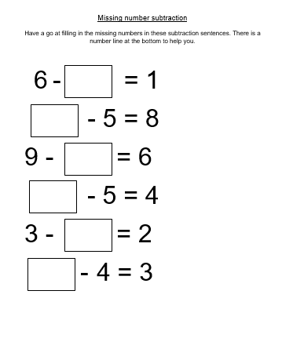
Now have a go at the worksheet

Slide 13
Slide 2 – Remember subtraction means take away. We are going to be learning how to find the missing number using a number line. Our number sentence is something takeaway 2 equals 8 . So, we need to start at 8 on our number line because that is our answer and we need to jump 2 numbers forwards. 2 jumps and we land on 10. The missing number is 10. 10 takeaway 2 equals 8.
Slide 4 – Lets try another one together. This time our missing number is in the middle of our number sentence. So this time we need to jump backwards. So we start at 7 and we need to do 3 jumps backwards. 1, 2, 3. we land on number 4. So 4 is our missing number. 7 takeaway 3 equals 4.
Slide 6 - Now try this one. Remember to jump forwards when the missing number is at the beginning.
Slide 7 - Now try this one, remember to jump backwards when the missing number is in the middle.
Slide 8 - Now try this one. Remember to jump forwards when the missing number is at the beginning.
Slide 12 – Now have a go at the work sheet.

