Slide 1
Maths
Multiplying by 10

Slide 2
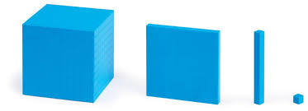
Thousand
Hundred
Ten
One
Multiplying by 10.

Slide 3
19 x 10 =
190
Th
H
T
O
1
9
1
9
0
Multiplying by 10.

Slide 4
47 x 10 =
470
Th
H
T
O
4
7
4
7
0
Multiplying by 10.

Slide 5
642 x 10 =
6420
Th
H
T
O
6
4
2
6
4
2
0
Multiplying by 10.

Slide 6
390 x 10 =
3900
Th
H
T
O
3
9
0
3
9
0
0
Multiplying by 10.

