Slide 1
Learning Intention: To find verbs

Slide 2
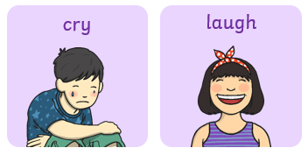
What is a verb?
A verb is a word, it is a doing word!
A verb is something that you can do.

Slide 3
Find the verbs:
run
school
sleep
table
Notes:
Listen to me read the words below, when you hear me say a verb, I need you to point at it and say, “Verb alert!”

Slide 4
Where are verbs?
Let’s find some in our story!
Notes:
Where are verbs? Verbs can be found in sentences. There are sentences in our story, Peter and the Wolf, let’s find them!

Slide 5
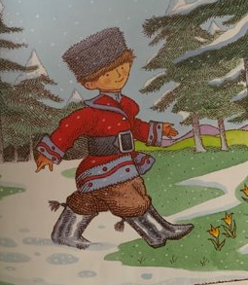
Peter can walk.
Notes:
Look at the picture. Who can we see? What are they doing?
Peter is walking. Peter can walk. VERB ALERT! I heard a verb (a doing word), the verb is walk.

Slide 6
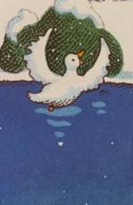
The duck can swim.
Notes:
Look at the picture. Who can we see? What are they doing?
The duck is swimming. The duck can swim. VERB ALERT! I heard a verb (a doing word). Is it duck? Is it can? Is it swim? Yes! The verb is swim.

Slide 7
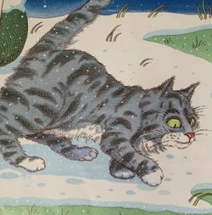
The cat can creep.
Notes:
Look at the picture. Who can we see? What are they doing?
The cat is creeping. The cat can creep. VERB ALERT! I heard a verb (a doing word). Is the verb the? Can you the? No! Is it cat, can you cat? No! Is it can? Can you can? No! Is it creep? Can you creep? Yes! The verb is creep.

Slide 8
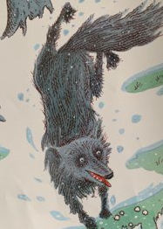
The wolf can run.
Notes:
Look at the picture. Who can we see? Wolf. What is he doing?
It looks like he is running after the duck. The wolf can run.
VERB ALERT! I can see a verb (a doing word). Let’s check each word to see which one is the verb. Can you… the? Can you wolf? Can you can? Can you run? Yes! Run is the verb.

Slide 9
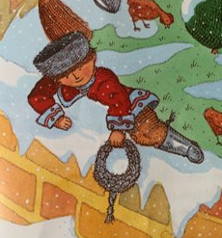
Your turn:
Peter can _______________.
Notes:
Your turn. Look at the picture. Who can we see? It’s Peter! What is Peter doing?
Peter is climbing. Verb alert! Climb. Finish the sentence using the verb, Peter can …

Slide 10
Your turn:
Peter can climb.
Notes:
Your turn. Look at the picture. Who can we see? It’s Peter! What is Peter doing?
Peter is climbing. Verb alert! Climb. Finish the sentence using the verb, Peter can …

Slide 11
Today’s verbs:
walk
swim
creep
climb
run

Slide 12
Commentary:
Slide 3: Listen to me read the words below, when you hear me say a verb, I need you to point at it and say, “Verb alert!” My turn, verb alert, your turn, verb alert.
Slide 4: Where are verbs? Verbs can be found in sentences. There are sentences in our story, Peter and the Wolf, let’s find them!
Slide 5: Look at the picture. Who can we see? What are they doing? Peter is walking. Peter can walk. VERB ALERT! I heard a verb (a doing word), the verb is walk.
Slide 6: Look at the picture. Who can we see? What are they doing? The duck is swimming. The duck can swim. VERB ALERT! I heard a verb (a doing word). Is it duck? Is it can? Is it swim? Yes! The verb is swim.

Slide 13
Commentary 2:
Slide 7: Look at the picture. Who can we see? What are they doing? The cat is creeping. The cat can creep. VERB ALERT! I heard a verb (a doing word). Is the verb the? Can you the? No! Is it cat, can you cat? No! Is it can? Can you can? No! Is it creep? Can you creep? Yes! The verb is creep.
Slide 8: Look at the picture. Who can we see? Wolf. What is he doing? It looks like he is running after the duck. The wolf can run. VERB ALERT! I can see a verb (a doing word). Let’s check each word to see which one is the verb. Can you… the? Can you wolf? Can you can? Can you run? Yes! Run is the verb.
Slide 9: Your turn. Look at the picture. Who can we see? It’s Peter! What is Peter doing? Peter is climbing. Verb alert! Climb. Finish the sentence using the verb, Peter can …

