Slide 1
Learning intention: To show understanding of a text.
Quiz time!

Slide 2
1. Name the five characters in the story.
2. Which character am I?
I was scared in the forest but brave at the witch’s house. I even rescued my brother!

Slide 3
3. Which character am I?
4. How did Hansel make a path to find his way home?
I was so happy when my children came home.

Slide 4
5. What was the witch’s house made of?
6. How do you know the witch was evil? Think of at least one reason.

Slide 5
7. What happened after Gretel pushed the witch in the oven?
8. What does the underlined word mean? Try to read the sentence by yourself.
The dad was glad.

Slide 6
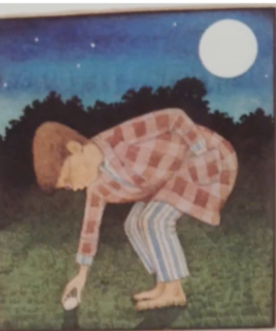
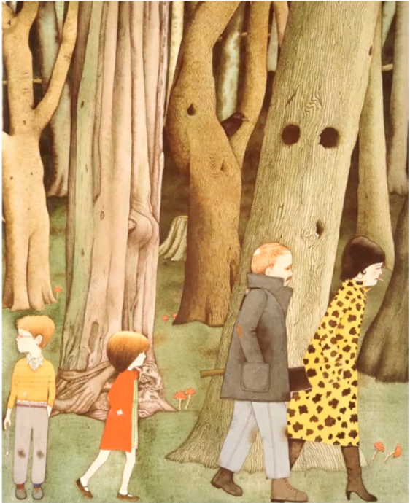
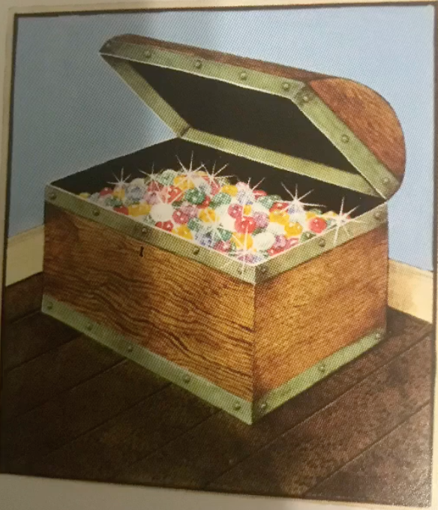
9. How do you think Hansel and Gretel felt at the start of the story?
10. How do you think Hansel and Gretel felt at the end of the story?

