Slide 1
Year 1 Maths Alternative 2
Learning intention: To begin to learn about time

Slide 2
Day
Night

Slide 3
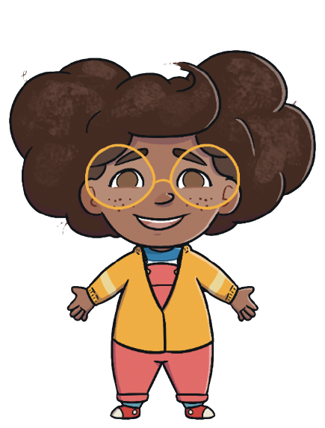
I am Mel.
This is what I do in the day and at night.
What do you do?

Slide 4
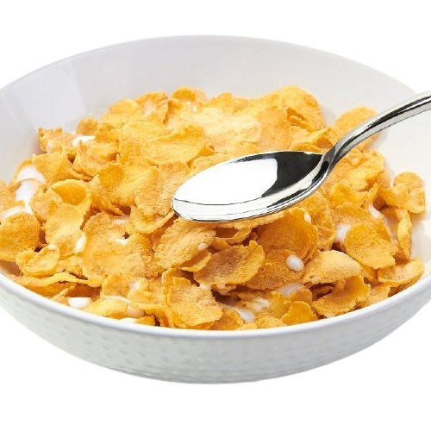
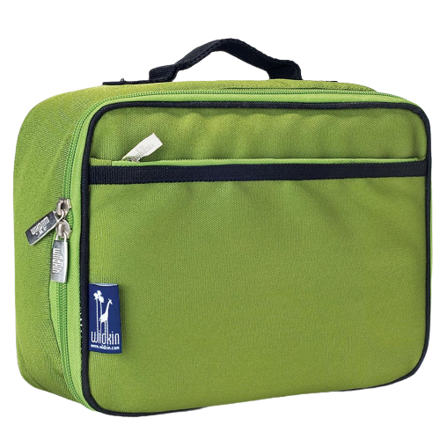
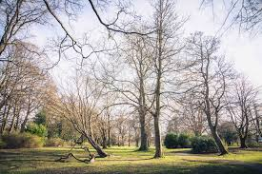
In the day I do this…

Slide 5
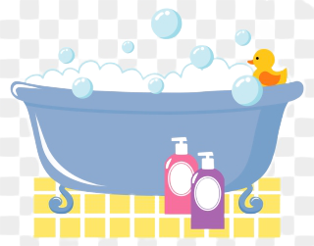
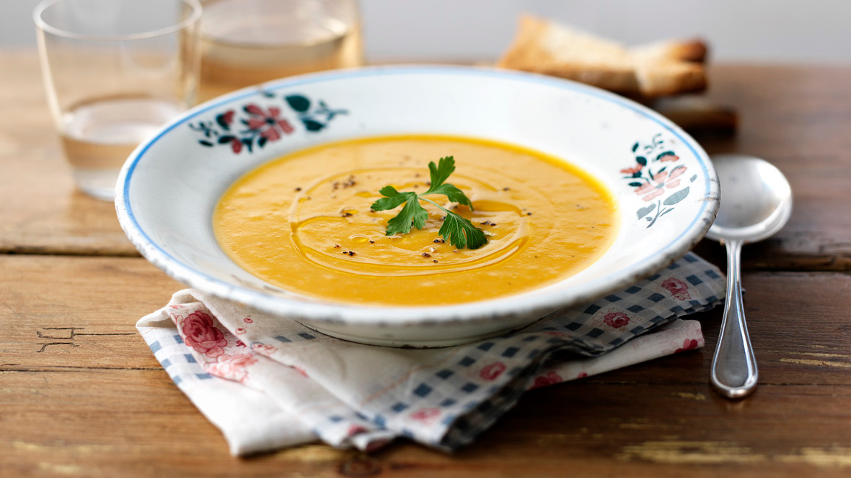
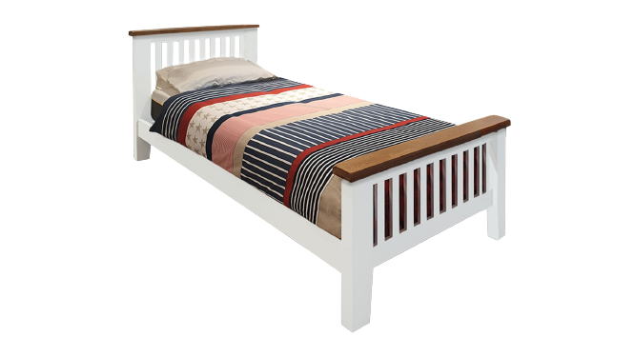
At night I do this…

Slide 6
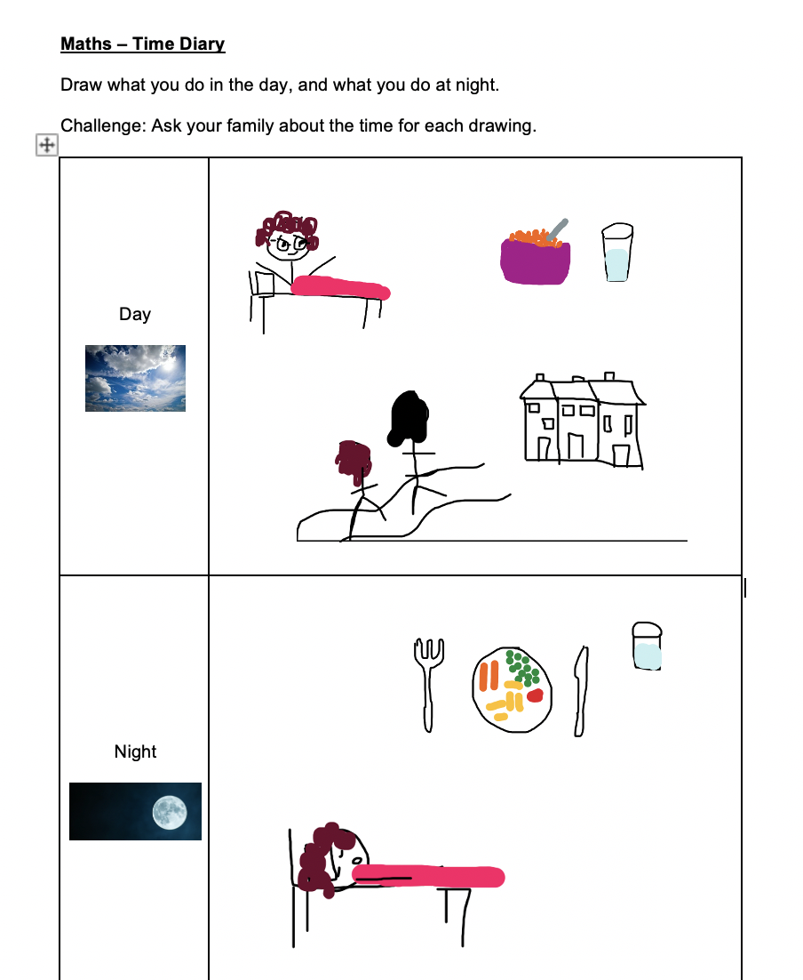
This is my time diary,
Now it is your turn!

