Slide 1
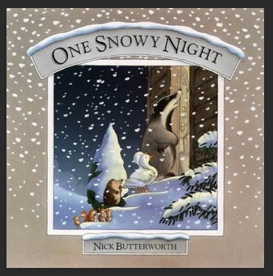
Quiz time Let’s see what you can remember about this story.

Slide 2
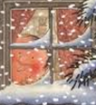
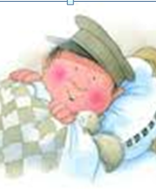
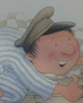
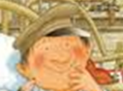
Who is this?

Slide 3
It is Percy the Park Keeper.
He is the main character in this story.

Slide 4
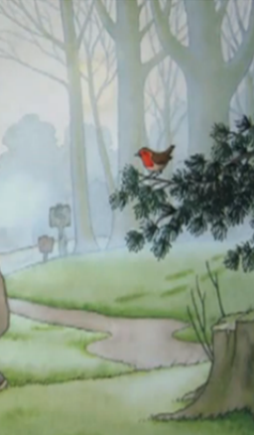
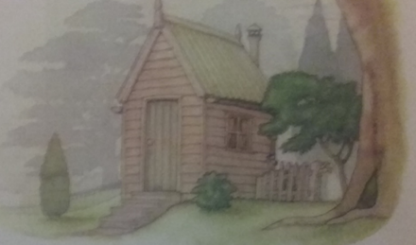
Where do the animals and Percy live?

Slide 5
This is the setting of the story.
They live in a park.

Slide 6
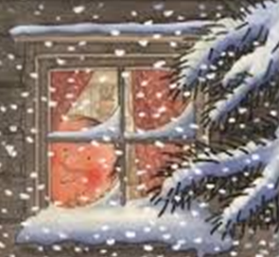
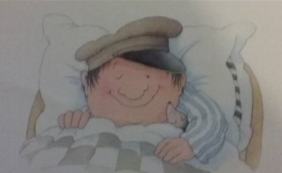
What is the weather like outside?
Is it day or night time?

Slide 7
It is winter and it is snowing. It is very cold outside.
It is night time and Percy went to bed.

Slide 8
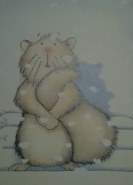
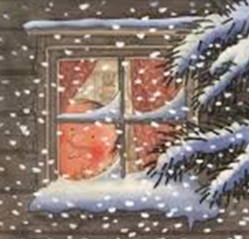
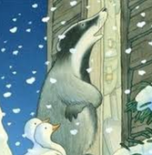
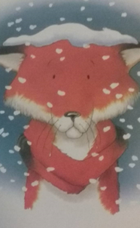
What did the animals in the park do?

Slide 9
The animals were cold outside. They knocked on the door of Percy’s hut. They wanted to go inside because they were too cold.

Slide 10
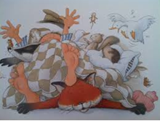
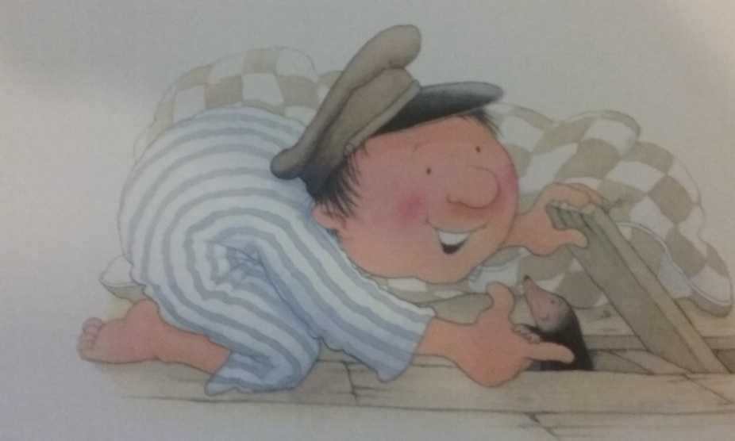
Why did the animals get a fright?

Slide 11
All of a sudden there was a loud creak. Little mole poked its head up from under the floorboards.

Slide 12
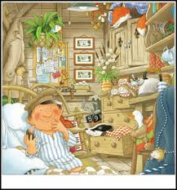
Did this story have a happy ending?

