Slide 1
Year two
Telling the time using an analogue clock.
Quarter past and quarter to

Slide 2
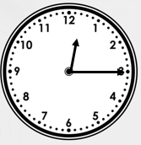
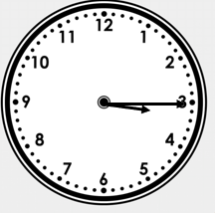
Quarter past times
A
B
It is quarter past 12.
The minute hand is pointing to the 3.
The hour hand is pointing between the 12 and 1.
It is quarter past 3.
The minute hand is pointing to the 3.
The hour hand is pointing between the 3 and 4.

Slide 3
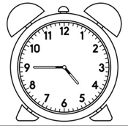
Quarter to times
A
B
It is quarter to 10.
The minute hand is pointing to the 9.
The hour hand is pointing between the 9 and 10.
It is quarter to 5.
The minute hand is pointing to the 9.
The hour hand is pointing between the 4 and 5.

Slide 4
Write the times shown on the clock
A
B
C
D

Slide 5
Answers
A
B
Quarter past 6 Quarter past 8
C
D
Quarter to 9 Quarter to 10

