Slide 1
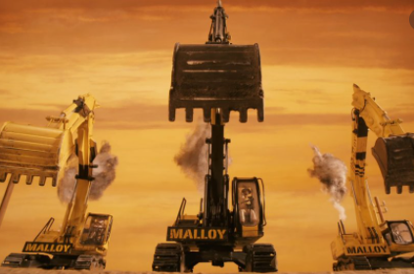
Fantastic Mr Fox
Chapter 5 The Terrible Tractors
What has happened so far?
Where are the foxes now?
Where are the farmers? What have they been trying to do?

Slide 2
We are now going to read chapter 5 of Fantastic Mr Fox
Task 1
Find sheet Mr Fox chapter 5 questions.
There are some questions on the sheet that you can find the answers for as you read and listen. The story will stop at the end of each slide to give you a change to check for the answer.
The questions are also on the next slide.
Think about your answers and then write them in clear sentences.
Task 2
Draw an illustration that you think would go well with any part of the story that you have read so far. This is explained further after the text.

Slide 3
Questions for chapter 5
1. On page one, what time of the day is it?
On page two, is says Bean never took a bath true or false
3. On page three, how long does Bean say it will take to dig out Mr. Fox?
4 On page four, what noises could the foxes hear coming from above them?
On page five, what does Mrs Fox think is happening?

Slide 4
Page 1
As the sun rose the next morning, Boggis and Bunce and Bean were still digging. They had dug a hole so deep you could have put a house into it. But they had not yet come to the end of the foxes’ tunnel. They were all very tired and cross.
‘Dang and blast!’ said Boggis. ‘Whose rotten idea was this?’
‘Bean’s idea,’ said Bunce.
Boggis and Bunce both stared at Bean. Bean took another swig of cider, then put the flask back into his pocket without offering it to the others. ‘Listen,’ he said angrily, ‘I want that fox! I’m going to get that fox! I’m not giving in till I’ve strung him up over my front porch, dead as a dumpling!’

Slide 5
Page 2
‘We can’t get him by digging, that’s for sure,’ said the fat Boggis. ‘I’ve had enough of digging.’
Bunce, the little pot-bellied dwarf, looked up at Bean and said, ‘Have you got any more stupid ideas, then?’
‘What?’ said Bean. ‘I can’t hear you.’ Bean never took a bath. He never even washed. As a result, his earholes were clogged with all kinds of muck and wax and bits of chewing-gum and dead flies and stuff like that. This made him deaf. ‘Speak louder,’ he said to Bunce, and Bunce shouted back, ‘Got any more stupid ideas?’

Slide 6
Page 3
Bean rubbed the back of his neck with a dirty finger. He had a boil coming there and it itched. ‘What we need on this job,’ he said, ‘is machines . . .mechanical shovels. We’ll have him out in five minutes with mechanical shovels.’
This was a pretty good idea and the other two had to admit it.
‘All right then,’ Bean said, taking charge. ‘Boggis, you stay here and see the fox doesn’t escape. Bunce and I will go and fetch our machinery. If he tries to get out, shoot him quick.’
The long, thin Bean walked away. The tiny Bunce trotted after him. The fat Boggis stayed where he was with his gun pointing at the fox-hole.
Soon, two enormous caterpillar tractors with mechanical shovels on their front ends came clanking into the wood. Bean was driving one. Bunce the other. The machines were both black. They were murderous, brutal-looking monsters.

Slide 7
Page 4
‘Here we go, then!’ shouted Bean.
‘Death to the fox!’ shouted Bunce.
The machines went to work, biting huge mouthfuls of soil out of the hill. The big tree under which Mr Fox had dug his hole in the first place was toppled like a matchstick. On all sides, rocks were sent flying and trees were falling and the noise was deafening.
Down in the tunnel the foxes crouched, listening to the terrible clanging and banging overhead. ‘What’s happening, Dad?’ cried the Small Foxes. ‘What are they doing?’

Slide 8
Page 5
Mr Fox didn’t know what was happening or what they were doing.
‘It’s an earthquake!’ cried Mrs Fox.
‘Look!’ said one of the Small Foxes. ‘Our tunnel’s got shorter! I can see daylight!’
They all looked round, and yes, the mouth of the tunnel was only a few feet away from them now, and in the circle of daylight beyond they could see the two huge black tractors almost on top of them.
‘Tractors!’ shouted Mr Fox. ‘And mechanical shovels! Dig for your lives! Dig, dig, dig! ’

Slide 9
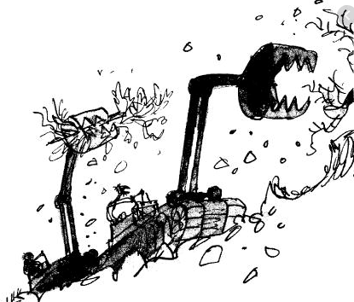
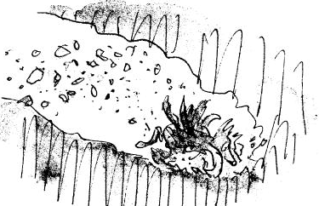
Task 2
Do a drawing of your favourite part so far. Add a caption to the drawing to explain what it shows. You could choose a sentence from the text as a caption. Use one of the examples below or choose one of your own.
For example;
‘Soon, two enormous tractors with shovels on their front ends came clanking into the wood.’
‘The machines went to work, biting huge mouthfuls of soil out of the hill.’
‘Down in the tunnel the foxes crouched, listening to the terrible clanging and banging overhead.’

