Slide 1
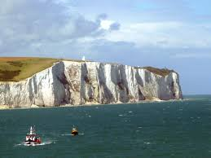
The White Cliffs of Dover

Slide 2
The White Cliffs of Dover
The White Cliffs of Dover are a famous landmark in the South East of England.
Many people come to visit this location and it has featured in many famous films and songs.

Slide 3
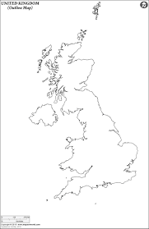
Where is it?
Using an atlas or google maps. Can you mark the White Cliffs of Dover on the map? (Clue: It is in the South East of England.)

Slide 4
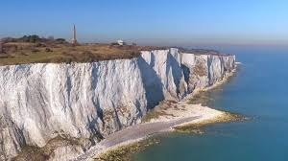
Why are they white?
Can you make a prediction for why you think the cliffs could be white?
Find out the answer on the next slide and see if you are correct!

Slide 5
Why are they white?
The cliffs are white because of the material they are made from.
The cliffs are made of a soft white stone called chalk. This is a physical feature so this stone is naturally this colour.
They are almost 100 million years old and have always been this bright white colour.

Slide 6
The cliffs in music
Have a listen to this song called “The White Cliffs of Dover” by Vera Lynn.
This song is from 1942 and was made during World War 2.
What do you think she is singing about?

Slide 7
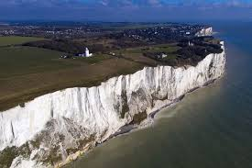
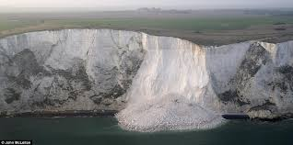
The changing cliffs
These cliffs are very old like we have discussed but they are changing. Have a look at these two pictures. What is the different and why do you think it has happened?
Find out why on the next page.

Slide 8
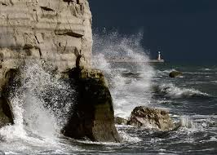
The changing cliffs
What is happening is that large parts of the cliffs are being washed into the sea, this is called coastal erosion.
This is where the weather like rain and storms, and the large waves crash against the soft rock and makes it break off.
We will look at coastal erosion in
more detail over the next few weeks.

