Slide 1
Make comparisons between two different poems

Slide 2
In Autumn, we studied the poem ‘Rocca San Giovanni.’ Re read the poem to familiarise yourself with the events.

Slide 3
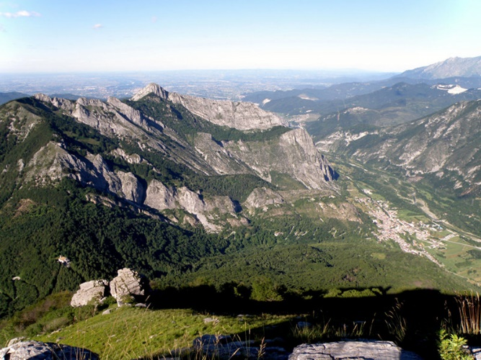
Setting
Think about the setting of both Rocca San Giovanni and The Highwayman.
Can you think of any similarities and differences?

Slide 4
Characters
Think about the characters in both Rocca San Giovanni and The Highwayman.
Can you think of any similarities and differences between the different characters?

Slide 5
Theme
Think about both poems.
What is the main theme in Rocca San Giovanni?
What is the main theme in The Highwayman?

