Slide 1
Year 1 Art

Slide 2
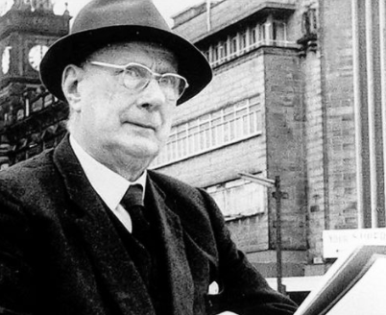
Can you remember our new artist?
It is Laurence Stephen Lowry.
Lowry was an artist who drew things that he could see.
This is called observational drawing.
Notes:
Can you remember our new artist? It is Laurence Stephen Lowry. He drew things he could see, this is called observational drawing.

Slide 3
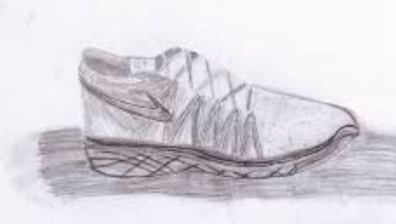
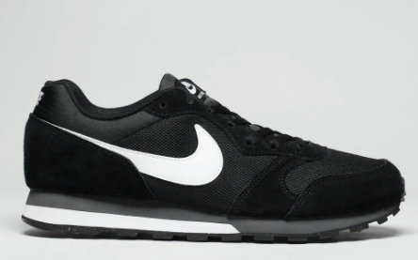
Observational drawing Observational drawing is when we look at something and draw what we can see.
It is important to think about size when you are doing observational drawing.
Notes:
Remember, observational drawing is when we look at something and draw what we can see. It is important to think about size when you are doing observational drawing.

Slide 4
Lets have another look at some of Lowry’s art work. Look at the size of the people, buildings and animals.
Notes:
Lets have another look at some of Lowry’s art work. Look at the size of the people, buildings and animals.

Slide 5
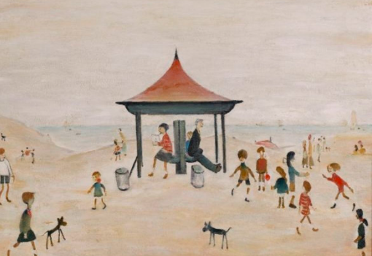
Notes:
What can you see that is drawn smaller than the children? Can you see the dogs? Can you see the ball?

Slide 6
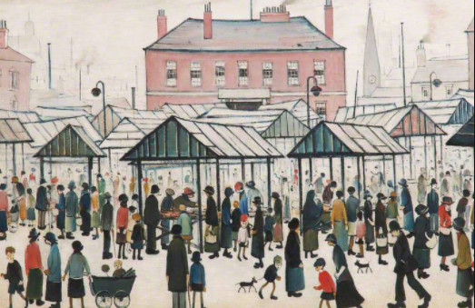
Notes:
Look at the different people and their sizes. Can you tell which ones are children and which are adults? Yes! The children are smaller. Children aren’t actually that small, but if you drew them to actual size you would need a HUGE piece of paper. The sizes need to make sense on the page.

Slide 7
It’s your turn to draw objects of different sizes. Choose something from home, or from this slide.
Notes:
Here are some objects from smallest (the apple) to largest (the door). It’s your turn to draw objects of different sizes. Choose something from home, or from this slide.

Slide 8
Commentary:
Slide 2: Can you remember our new artist? It is Laurence Stephen Lowry. He drew things he could see, this is called observational drawing. Slide 3: Remember, observational drawing is when we look at something and draw what we can see. It is important to think about size when you are doing observational drawing.
Slide 4: Lets have another look at some of Lowry’s art work. Look at the size of the people, buildings and animals.
Slide 5: What can you see that is drawn smaller than the children? Can you see the dogs? Can you see the ball?
Slide 6: Look at the different people and their sizes. Can you tell which ones are children and which are adults? Yes! The children are smaller. Children aren’t actually that small, but if you drew them to actual size you would need a HUGE piece of paper. The sizes need to make sense on the page. Slide 7: Here are some objects from smallest (the apple) to largest (the door). It’s your turn to draw objects of different sizes. Choose something from home, or from this slide.

