Slide 1
Learning intention: to plan instructions.
Can you remember all of the important features of instructions?

Slide 2
Learning intention: to plan instructions.
Imperative verbs (bossy verbs)
Second person (you)
Instructions in lists (e.g. touch the handle, open the gate and go through it)
Numbers or bullet points
Numbers or bullet points
Second person
Imperative verbs
Lists

Slide 3
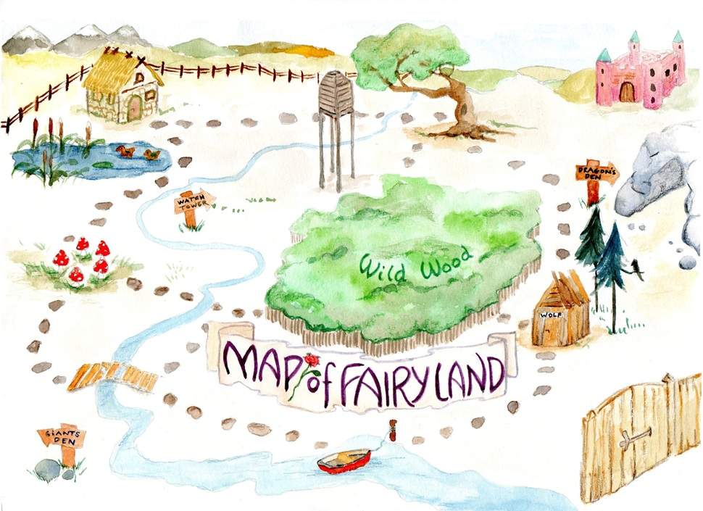
Learning intention: to plan instructions
You are going to be writing instructions for an adventure! Using the story map from last lesson, add any imperative verbs or ‘Wow!’ words you liked from the ‘Instructions’ story.

Slide 4
I want to borrow ‘Wow’ words from the story. Have a think about what they mean… would they fit with your instruction map? Can you think of any better words?
undergrowth
ferryman
trust
castle
journey
return
remember

Slide 5
I have added some ‘Wow’ words and imperative verbs to my map to help me to write my instructions tomorrow. What else can I add?
Now it’s your turn…
journey
go travel
begin
slimy, green goblin
trust
rainbow shark’s dangerous den
return

