Slide 1
Learning Intention – To explore our new poem

Slide 2
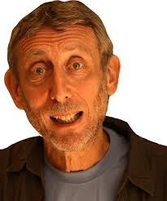
Who Started It?
Our new poem is called “Who Started It?” by Michael Rosen.
Michael Rosen is a very famous poet, who has written many poems, mainly for children.
What do you think this narrative poem could be about?

Slide 4
Today’s task
Listen this poem again with someone in your house, what do you like and dislike about the poem? Why?
Can you try to read one part of the poem yourself. Listen to my reading and try to copy how I have read the poem. You could try to perform this to someone in your house.

