Slide 1

Maths
Learning Intention: To add fractions

Slide 2


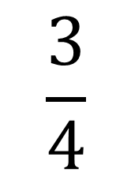
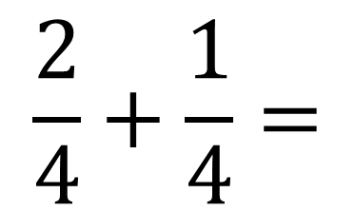

$$\frac{2}{4}+\frac{1}{4}=$$
$$\frac{3}{4}$$

Slide 3


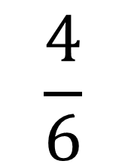
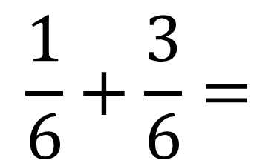


$$\frac{1}{6}+\frac{3}{6}=$$
$$\frac{4}{6}$$

Slide 4

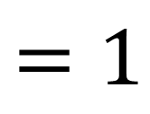


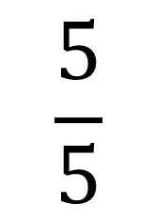
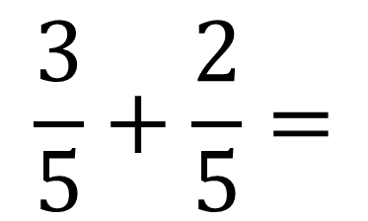


$$\frac{3}{5}+\frac{2}{5}=$$
$$\frac{5}{5}$$
$$=1$$

