Slide 1
History Learning Intention – To identify the difference between invaders and settlers.

Slide 2
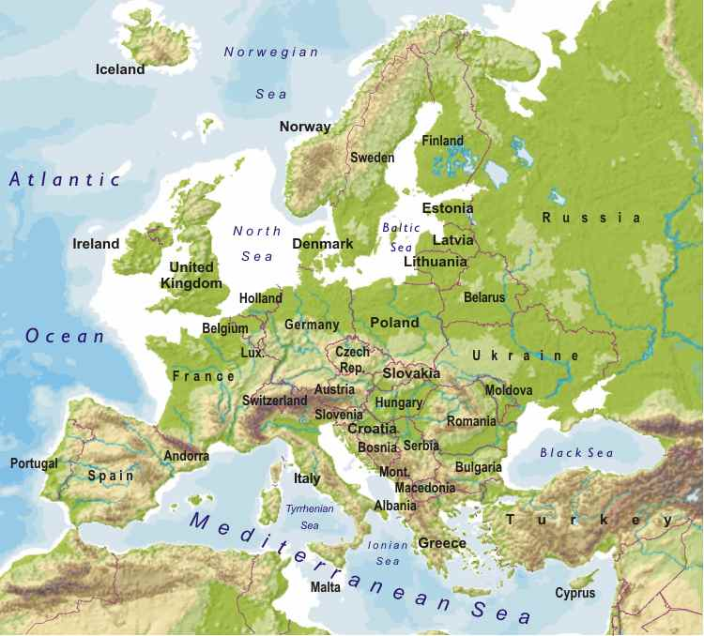
Where did the Vikings come from?
The Vikings came from a number of countries known collectively as Scandinavia: modern Denmark, Norway and Sweden.

Slide 3
Why did the Vikings leave Scandinavia?
Read the information sheet to find out.

Slide 4
What is the difference between an invader and a settler?

Slide 5
What is the difference between an invader and a settler?
Invaders enter a country by force and want to attack it.
Settlers build homes on land that is new to them.

Slide 6
Your task:
Sort the words onto the worksheet into whether they apply to invaders or settlers. Explain your reasons for each.

